Slide 1
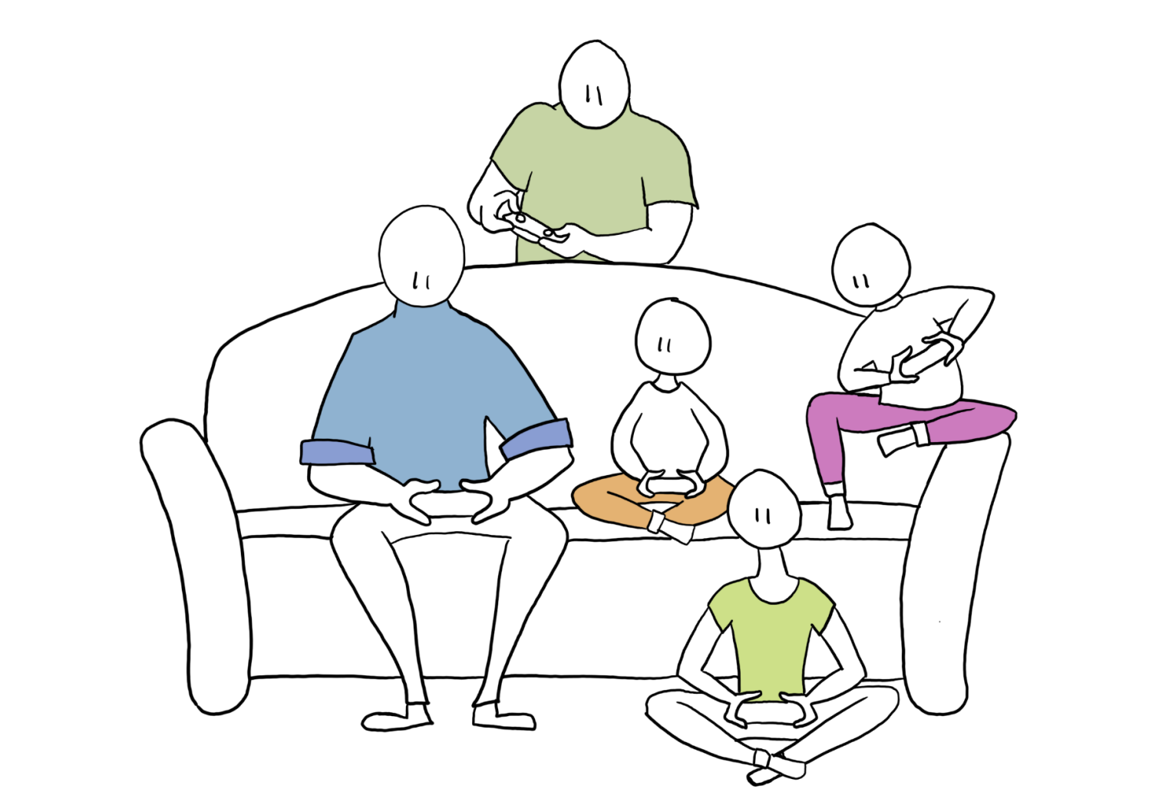
Interventions to support children and youth in the digital environment: Reflections from the DigiGen project
Prof. Halla B. Holmarsdottir - Oslo Metropolitan University (DigiGen Scientific Coordinator)
Holly Shorey- COFACE Families Europe Project and Advocacy Officer
COFACE Breakfast Byte, 8 February 2023
Notes:
16 SES 11 A: Teaching with ICT during a Pandemic
Time:
Thursday, 25/Aug/2022:
11:30pm - 1:00pm
Session Chair: Greta Björk Gudmundsdottir; gretag@ils.uio.no
Location: Int.2.416
4th floor, right wing of YSU
Who we are from OsloMet and University of Oslo
Focus in this presentation:
Covid 19
Young people as co-researchers AND WHAT THEY ARE CONCERNED ABOUT
Methodological approach – involving young people in research on themselves, participatory approach

Slide 2
DigiGen aims
To develop significant knowledge about how children and young people use and are affected by the technological transformations in their everyday lives.
To explain the conditions under which harmful versus beneficial effects of digital technology use by children and young people occur to develop effective social, educational, health and online safety policies, practices and regulations.
Our starting point: a conceptual ecological systems model

Slide 3
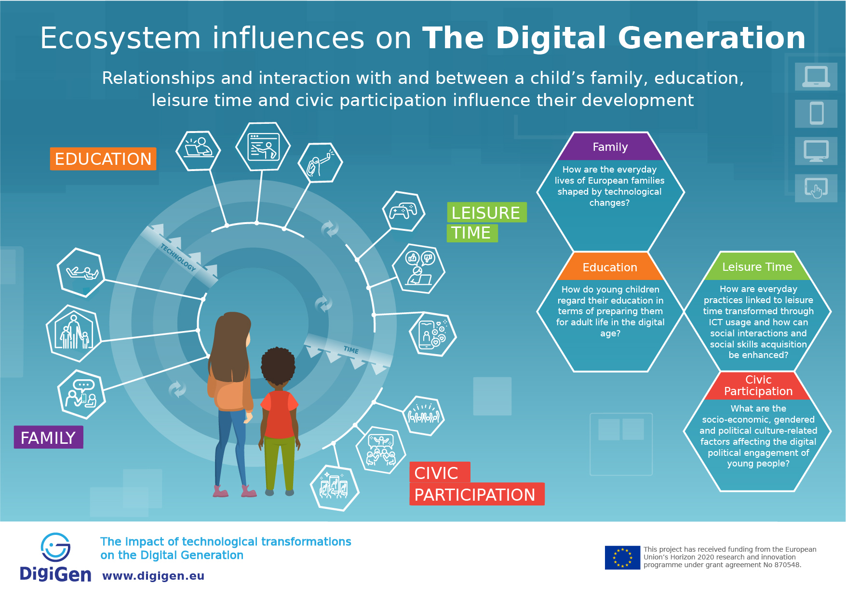
Notes:
In a recent working paper, we provide a first step in contributing to a more precise understanding of the concepts of vulnerability and risk concerning ICT use. This will be elaborated on in our upcoming book as well. For instance, in the book, we consider what it means to be vulnerable or at risk. In our investigation of this question, there is a need likewise to consider the digital activities and the ideal uses of technology that form a bridge between the various ecosystems surrounding the digital generation and the technology itself.
Of course, we acknowledge that before we can begin considering the use and value of digital technology, the question of access is particularly important. Sara Allyón will elaborate on this in her short presentation. Furthermore, the broader discussion around access is elaborated on in several of our working papers focusing on the various microsystems that children and young people interact with and the relationships within and between them.

Slide 4
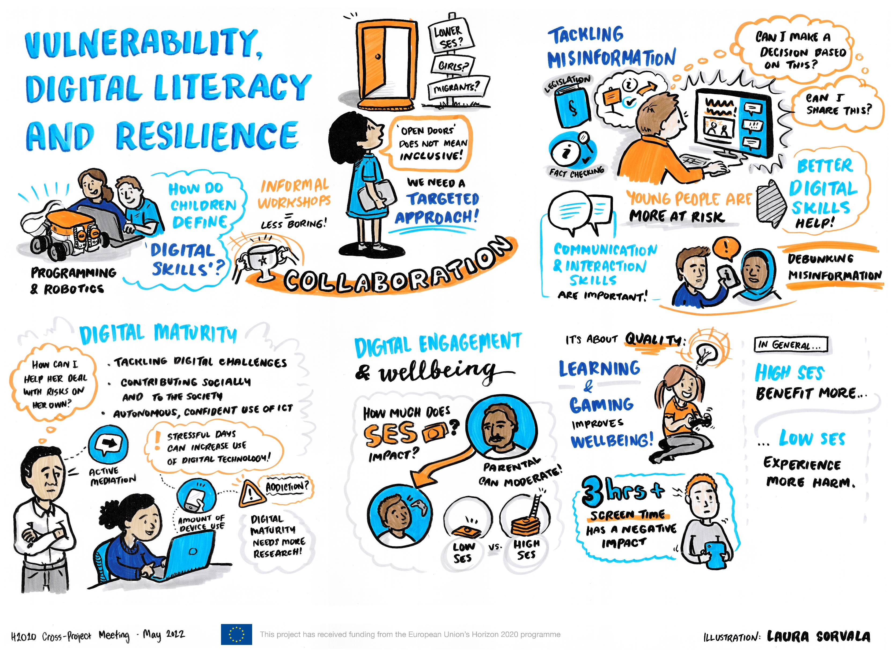
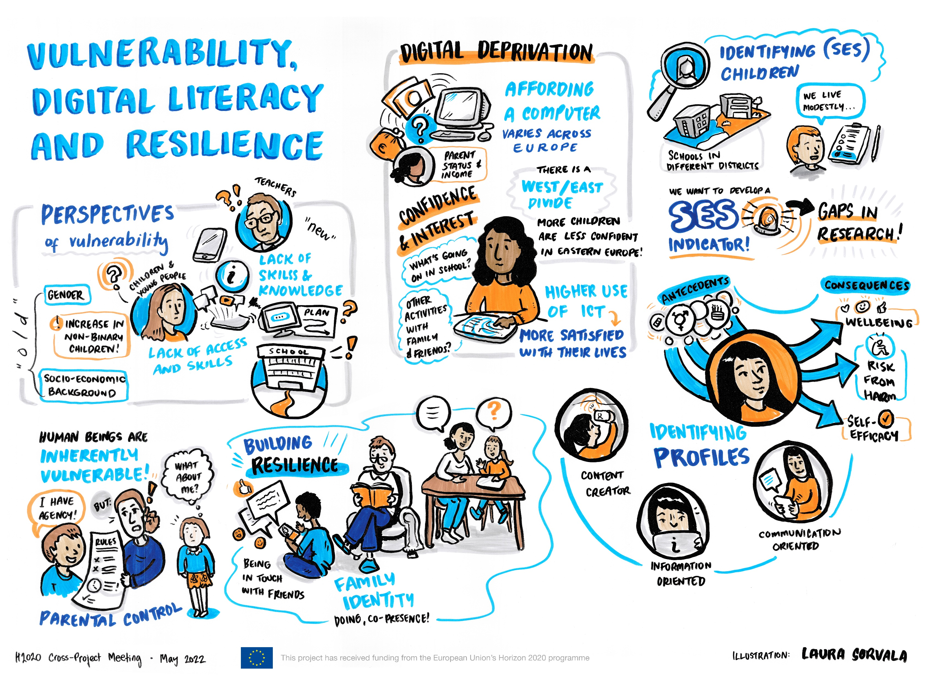
Benefits, risk, vulnerability and resilience
Notes:
With the growth of digital technology, there are both benefits and risks. While the risks have been well documented and include, for example, negative health effects on sleep, attention, and learning; exposure to inaccurate, inappropriate, or unsafe content and contacts; and compromised privacy and confidentiality. In DigiGen we have also focused on the benefits of digital technology as it relates to the everyday lives of children and young people to contribute to a better understanding of resilience.

Slide 5
Key findings – quantitative data
Digitally deprived children in Europe
5.4% of school-aged children in Europe are digitally deprived – Mediterranean and Eastern European Countries show higher rates.
Digital deprivation particularly affects children with severe material deprivation, that cohabit with low educated parents and are in poverty.
Digitally disengaged and digitally unconfident children in Europe
5.7% of children in Europe are digitally disengaged and 8% lack digital confidence –higher rates in Eastern European countries.
Both phenomena affects more markedly children facing grade repetition, being bullied or with no sense of belonging to school.
ICT and children’s subjective well-being
Children’s use of different technologies is positively associated with their subjective well-being (as reported by themselves).
No evidence of ICT crowding-out other activities e.g., relaxing with family members.

Slide 6
DigiGen original qualitative data
Empirical data | Children and young people (CYP) |  |  |  |  | Total CYP | Adults |  |  |  | Total Adults
 | Age group 5-6 | Age group 8-10 | Age group 9-16 | Age group 10-15 | Age group 15-18+ |  | Parents | Teacher candidates | Teachers | National stakeholders
Family interviews (individual interviews) (WP3) | 29 | 30 |  |  |  | 59 | 65 |  |  |  | 65
Focus groups (WP3) | 79 | 97 |  |  |  | 176
Interviews (WP4) |  |  |  | 85 |  | 85
Game observations (WP4) |  |  |  | 22 |  | 22
App diaries (WP4) |  |  |  | 50 |  | 50
Interviews Pilot study (WP5) |  |  | 26 |  |  | 26 |  |  |  | 4 | 4
Interviews (WP5) |  |  | 43 |  |  | 43 |  |  | 37 | 14 | 51
Interviews video workshop (WP5) |  |  | 50 |  |  | 50 |  | 21 |  |  | 21
Netnography interviews (WP6) |  |  |  |  | 65 | 65
Focus group interviews (WP6) |  |  |  |  | 12 | 12
TOTAL | 108 | 127 | 119 | 157 | 77 | 588 | 65 | 21 | 37 | 18 | 141

Slide 7
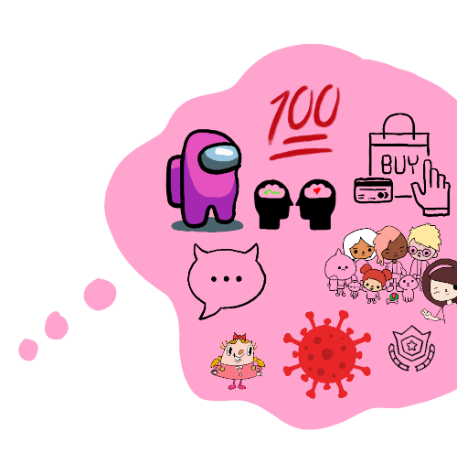
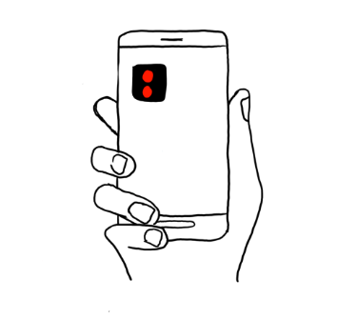
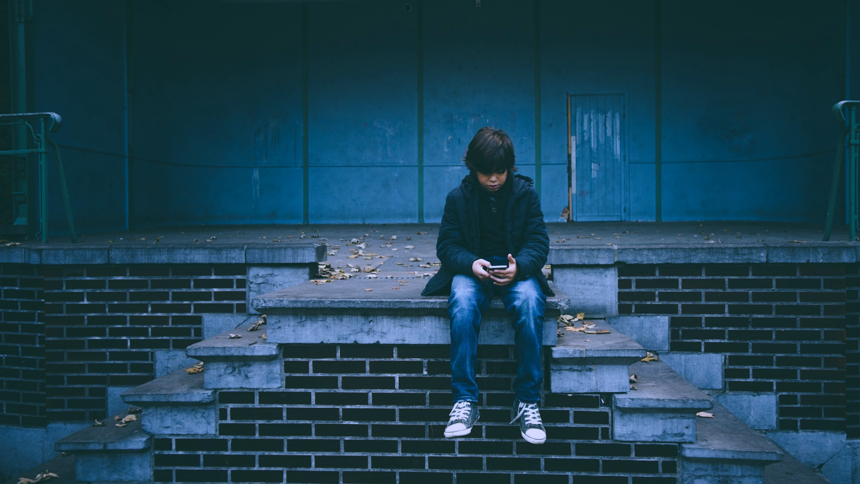


Children and young people as co-researchers
Notes:
We know a lot about digital technology, mainly from an adult perspective, but we know less from the perspective of children and young people. Thus, for DigiGen, it was crucial to include children and young people in our research as co-researchers.
We met them in their everyday digital lives (via their mobile phones, gaming and we invited them into our world as researchers)
Our goal was to take them seriously and include them as real co-researchers and active participants in the research
This has given us a unique insight into their use of digital technology
For example, we developed an app where children could share screenshots from their mobile phones and show us what they are doing when using digital technology and with whom. Of course, fulfilling the GDPR requirements.

Slide 8
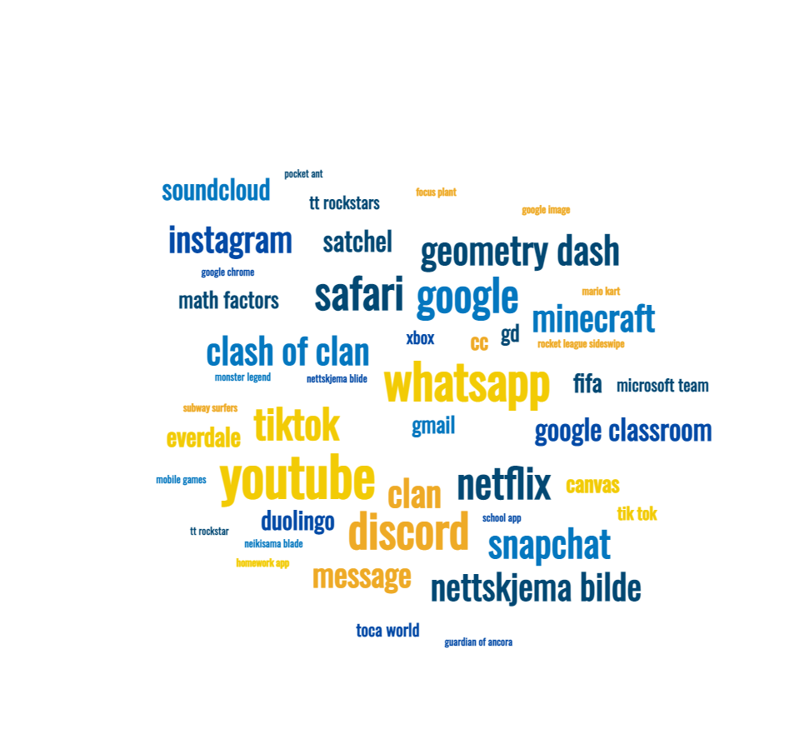
What are they using and the types of activities?
Notes:
Roughly 60 children and young people ages 10-16 from Norway, UK and Austria have shared daily diaries via the app focusing on how they use digital technology.
The word cloud represents information from their «screentime» for the three most used apps that day. The size of the word represents the number of times it was reported.
The word cloud shows both the most used apps – and these are indicators of the types of activities they spend most time doing
communication: whatsapp, message, discord, snapchat, Instagram, tiktok etc,
gaming/ playing together: clash of clan, fifa, Minecraft etc.,
school/ learning: google classroom, school app,
entertainment: Netflix, soundcloud, youtube etc).
This is confirmed in the next slide.

Slide 9
What do they use digital technology for?
Notes:
Again here we see what they are doing with reference to time spent on various activities.

Slide 10
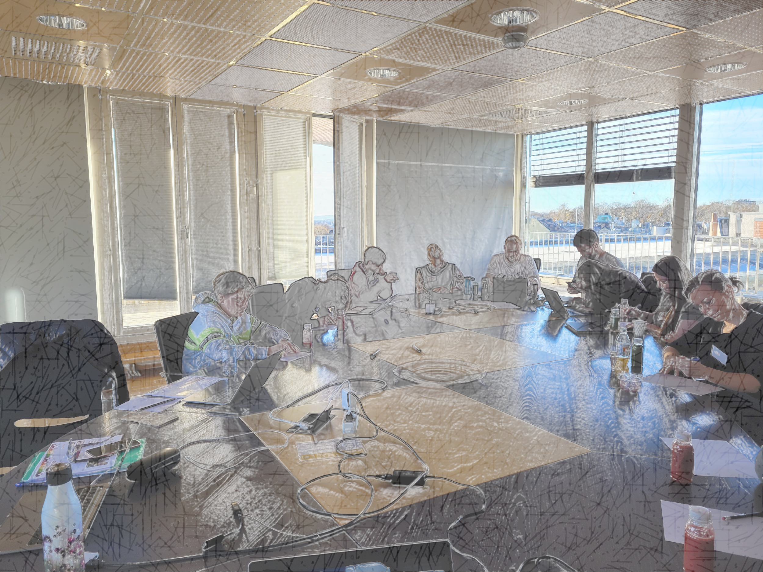
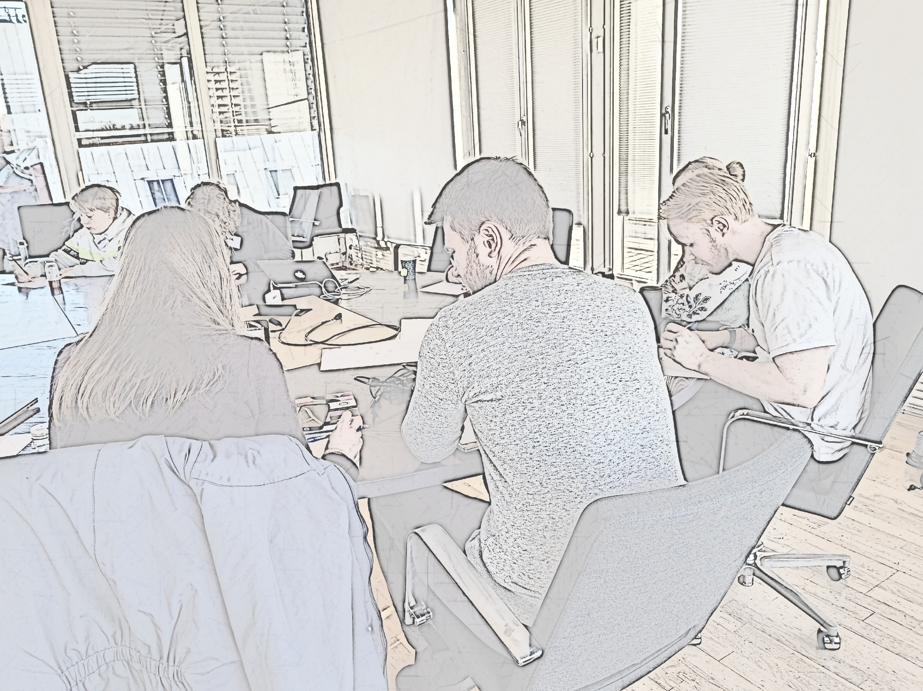
Children and young people researching each other
Unique insight into the reflections and experiences of children and young people
Active participation – exploratory method*
Important input on topics, future research and recommendations
* Bradbury-Jones, C., & Taylor, J. (2015). Engaging with children as co-researchers: challenges, counter-challenges and solutions. International Journal of Social Research Methodology, 18(2), 161–173. https://doi.org/10.1080/13645579.2013.864589
Notes:
But it wasn't just self-reporting of children and young people’s use that we were interested in.
In DigiGen, the children and young people were also co-researchers and had the opportunity to research each other. This gave us unique insights into their experiences and reflections.
Involving young people as co-researchers and experts in our research provides a participatory and exploratory approach to the topic (Bradbury-Jones, 2014). We used exploratory methods in the research, and they were active participants.
We received some very important input from the children and student teachers on topics, future research and, not least, recommendations to decision-makers.

Slide 11


Children’s voices about adult’s
I would listen to what my parents had to say, but after I started searching for information [online] I decided that their view doesn’t really work for me (CYP age 16)
I think it’s like a child wants to go play with dad, but dad wants to watch the computer instead. I think he’s actually done all the work, but he’s watching a video on YouTube (CYP age 8)
Teachers are often not on social media, and if they want to have a lesson about being bullied, they do not know how it is to be bullied on social media, and they think it only happens at school. The explanations from teachers are just like “be nice to each other”, but they do not understand (CYP age 12)
Sometimes Grandma comes and says: ‘Why are you looking at this stupid video?’ and right then she’s shutting down the computer. I tell her it’s interesting to me, but she won’t let me or doesn’t listen (CYP age 6)

Slide 12
Children’s voices – positive aspects
I really like TikTok it makes me very happy (CYP age 10)
It’s nice to relax in bed with my iPad and cuddle with my teddy bears (CPY age 6)
The smartphones are useful to make calls, take pictures, send messages. I also made video calls with ten people during vacation. The robots can help us to clean the house, the smartwatch is useful to listen to music and make calls (CYP age 9)
Saturday night is family film night and my favourite thing is to watch a movie with my parents on the HBO or Netflix app (CYP age 9)

Slide 13
Children’s voices on risks and responsibilities
It is important to think you should not comment on things you would not say to someone face to face (CYP age 12)
What is dangerous?
Hackers, people that
stalk you and pedos
CYP age 13)
Many parents don’t know that much about Roblox and they don’t know why it’s our favourite. There are a billion games and if parents say no about a game due to age limit then you can just go on Roblox and you can play what you want like GTA. I don’t think they know about that (CYP age 9)
If my dad can Google how to put on the parent control, then I can Google how to remove it (CYP age 9)

Slide 14
Children’s voices on technology in the future
I think we will have much more VR (virtual reality)” (CYP age 12)
Maybe in the future some PCs will have a chip linked to our brains (CYP age 13)
In the future people who did not grow up with an iPhone, they do not understand as much, and it gets harder or it gets more complicated for them I think (CYP age 12)
It would be nice to use a little bit more gaming and stuff like that. …maybe something more practical like VR to learn Greek history. Then we could learn a lot. Even those least motivated would be interested to learn (CYP age 13)

Slide 15
Summary and implications
Children and young people
Adults
1
Children want adults who understand their use of digital technology and adults they can talk to
1
Adults focus heavily on online dangers and/or screen time
2
They are unsure about adults' digital competence and often think they are better than adults
2
Adults may think that children are super users, while they often lack basic digital skills
3
They are unsure of what adults can contribute and therefore do not seek advice
3
Adults have limited access to the digital lives of children and young people
4
Blurred distinctions between online/offline; use between different microsystems
4
Use in one microsystem can greatly affect other microsystems
5
The lonely child who is ignored or not invited to participate (excluded)
5
The importance of working with exclusion, inclusion and seeing the lonely child – also online

Slide 16


Summary and implications
Children and young people
Adults
1
Children want adults who understand their use of digital technology and adults they can talk to
1
Adults focus heavily on online dangers and/or screen time
2
They are unsure about adults' digital competence and often think they are better than adults
2
Adults may think that children are super users, while they often lack basic digital skills
3
They are unsure of what adults can contribute and therefore do not seek advice
3
Adults have limited access to the digital lives of children and young people
4
Blurred distinctions between online/offline; use between different microsystems
4
Use in one microsystem can greatly affect other microsystems
5
The lonely child who is ignored or not invited to participate (excluded)
5
The importance of working with exclusion, inclusion and seeing the lonely child – also online

Slide 17
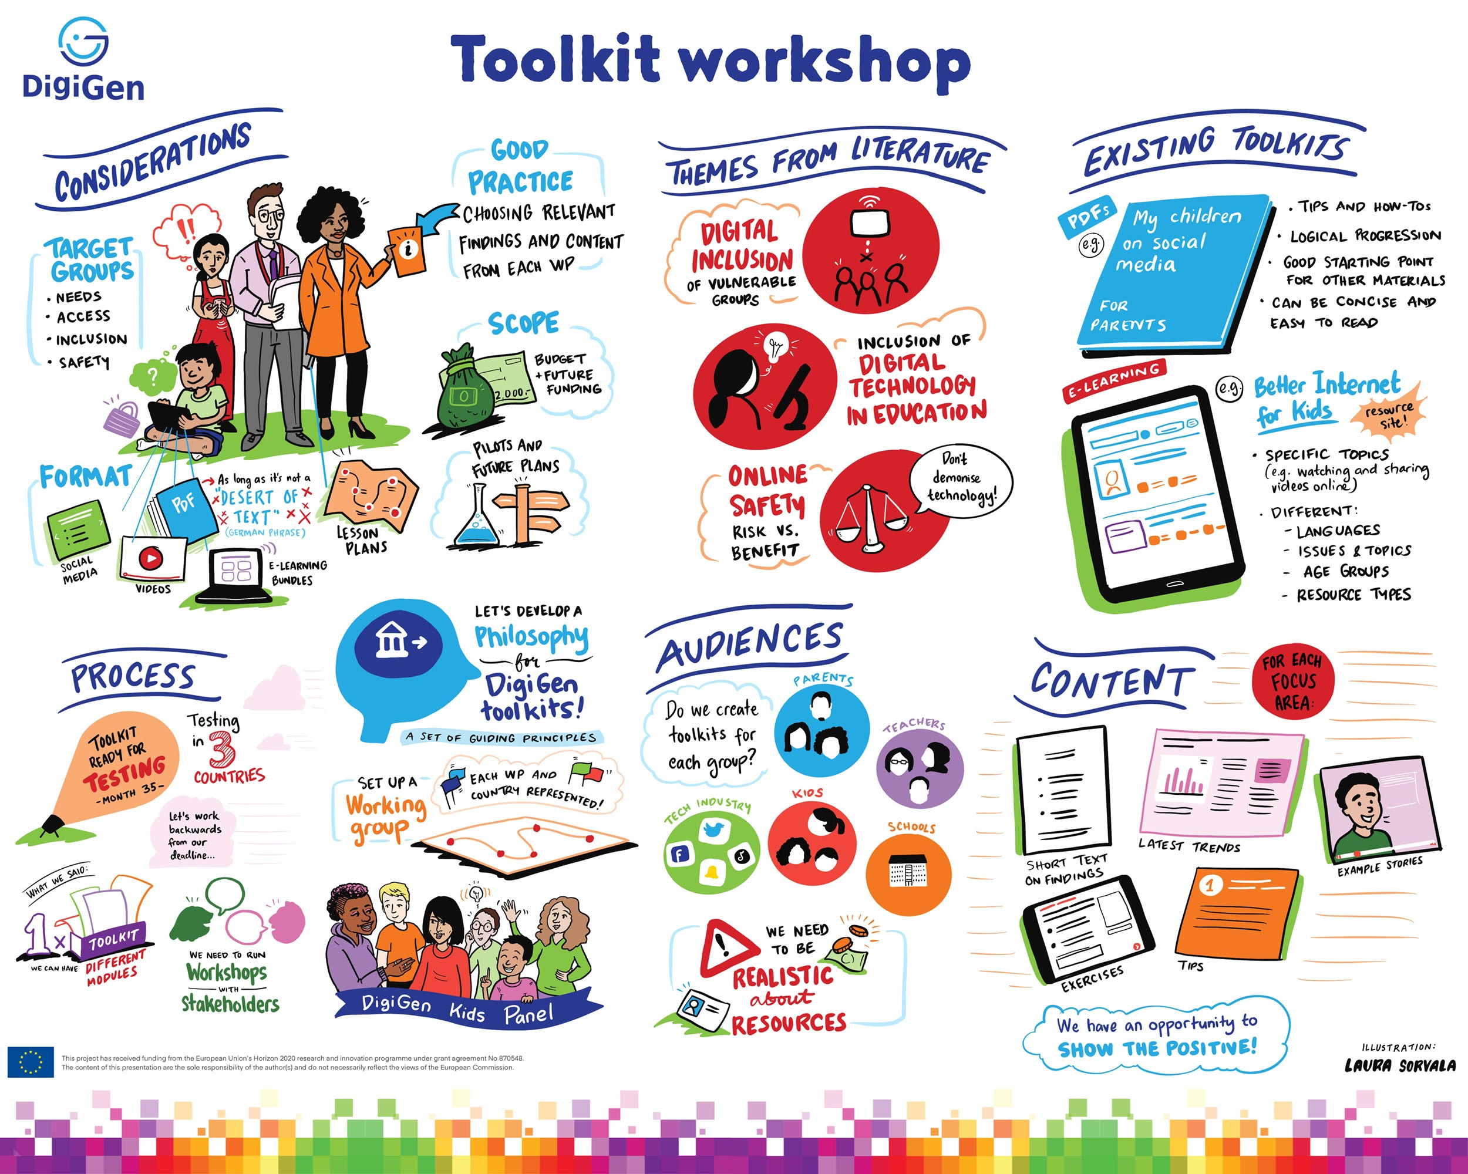

Slide 18
DigiGen toolkit
Promoting dialogue: the DigiGen ‘good practice toolkit’ TALK! for improving practice and policies.
  Developed based on a large amount of qualitative data from children and young people
  Developed in English and translated into German, Greek, Norwegian and Romanian languages
  Target group children and young people age 10-14 to be used in collaboration with adults
  Conversation cards to encourage discussions around positive and not only negative digital media experiences
  https://tenk.faktisk.no/foreldre

Slide 19
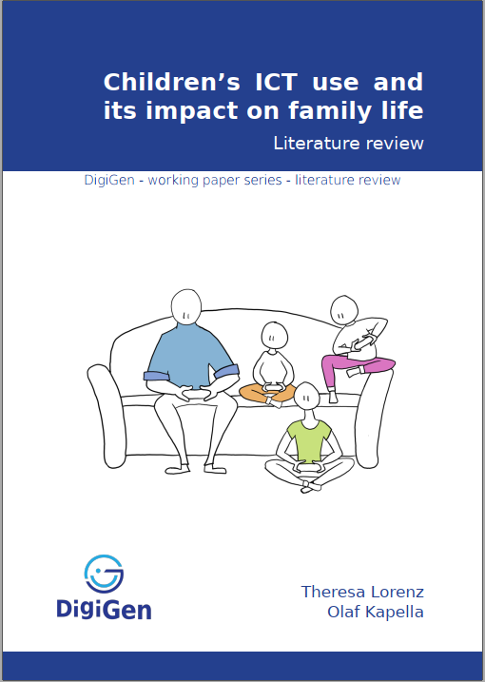
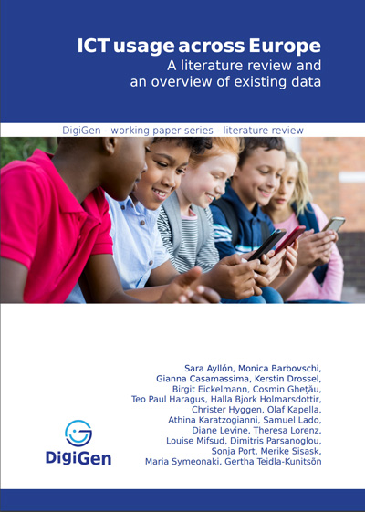
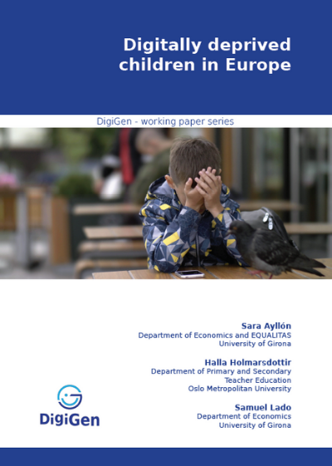

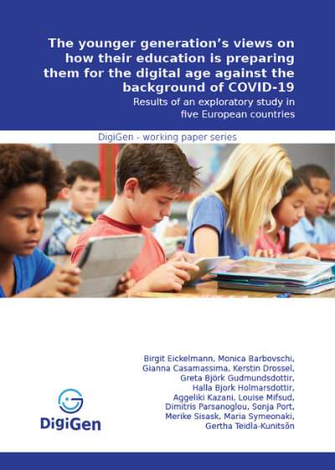

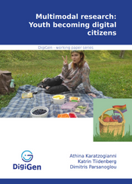
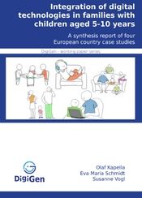
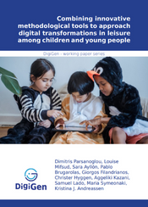
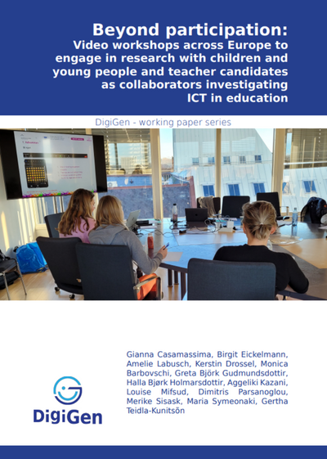
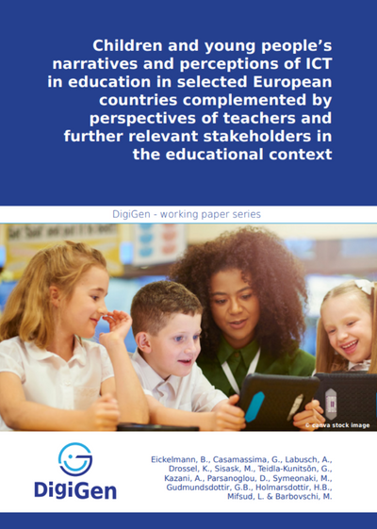
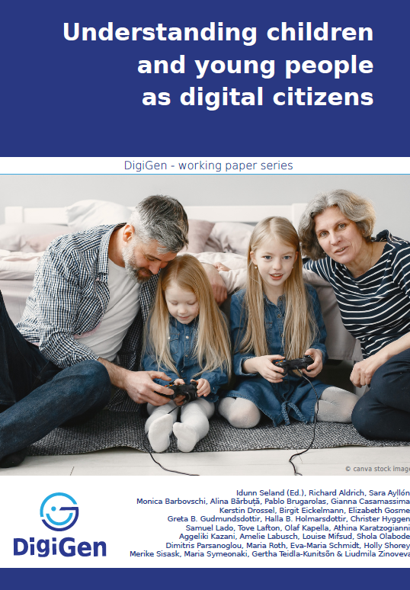
Working paper series

Slide 20
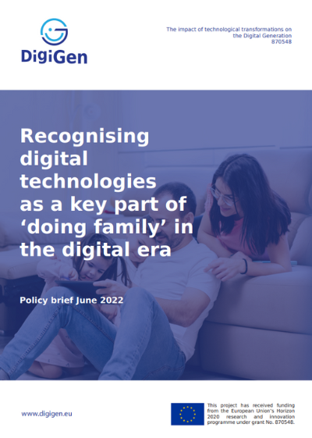
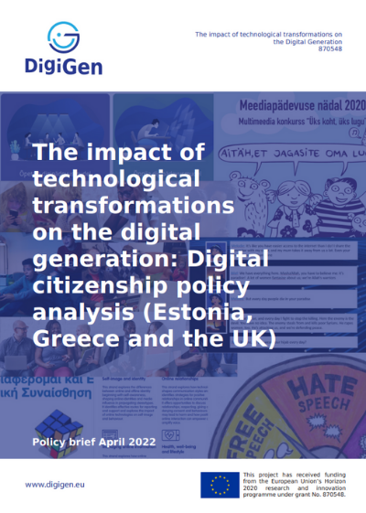
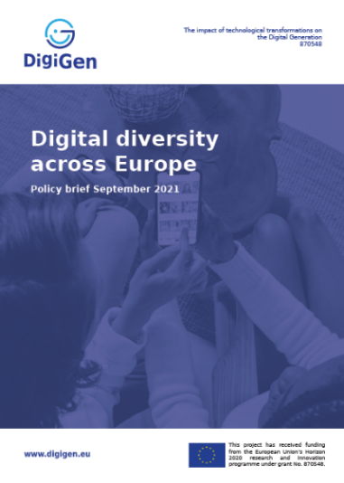
DigiGen policy briefs

Slide 21
Research shows that developing children and young people’s broader digital access and social competences can support their agency as digital citizens
Together for a better internet:
Policymakers (EU and national)
Industry (including beyond technology companies)
Civil society and families

Slide 22
Ensuring access to digital devices, connectivity, and a digital environment that enables children’s active participation as digital citizens
Tackling the digital divide as a social rights issue (internet connectivity and digital devices)
And also beyond?
Meaningful access to the civic space as digital citizens
Recognising children’s civic participatory rights (freedom of expression, association, access to information)

Slide 23
Fostering development of digital competences
(digital skills, media literacy, and social competences)
Emphasis on development of broader social competences such as negotiation, mediation, problem solving, and communication skills as a resilience enhancing factor against potential risks (Kapella et al, 2022)
Empathy, mutual respect, and team work across generations

Slide 24

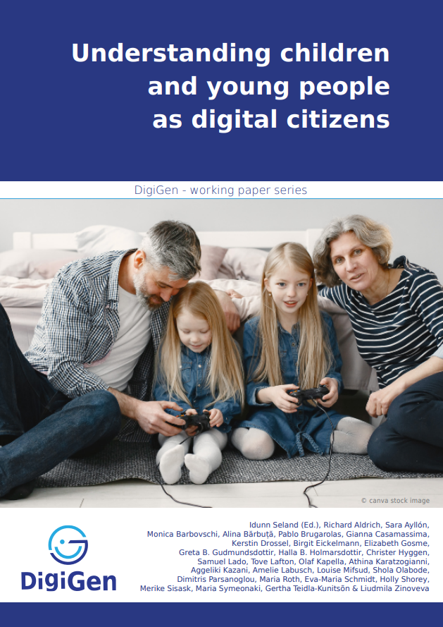
To read more (see chapter 9 page 148)

Slide 25
https://www.digigen.eu
Notes:
https://www.digigen.eu/wp-content/uploads/2022/04/DigiGen-Working-paper-8-family-life-website-final.pdf
https://www.digigen.eu/wp-content/uploads/2021/09/The-younger-generations-views-on-how-their-education-is-preparing-them-dor-the-digital-age-against-the-background-of-COVID-19-DigiGen-working-paper-no.-5.pdf

