Slide 1

CARE AND Education 0–6
The PoliMillegiorni Program in Save the Children’s 2025-30 strategy
Ensuring equitable, inclusive and quality education from early childhood
PREVENTION THROUGH CROSS-SECTORAL COLLABORATION

Slide 2


CARE AND Education 0–6: WHY
1.The cognitive, socio-emotional and relational SKILLS of human beings are consolidated between birth and the first 6 years of life.
2.In particular,in the first 1000 days of life (from conception to 2 years) the architecture of the human brain is built.
3.Early childhood development occurs in several interconnected areas: physical, cognitive, linguistic, and socio-emotional. Children exposed to problems such as poverty, malnutrition, poor health and an unstimulating family or educational environment, slow down their development and DO NOT REACH THEIR FULL POTENTIAL
All the programs in the Zero-six area refer to the five spheres of the Nurturing Care Framework for Early Child Development approach: health, healthy eating, protection, responsive parenting, early education.
“Save the Children’s vision is to scale holistic and transformative ECCD programs, where young children are respected, safe, nurtured, and co-create learning”

Slide 3
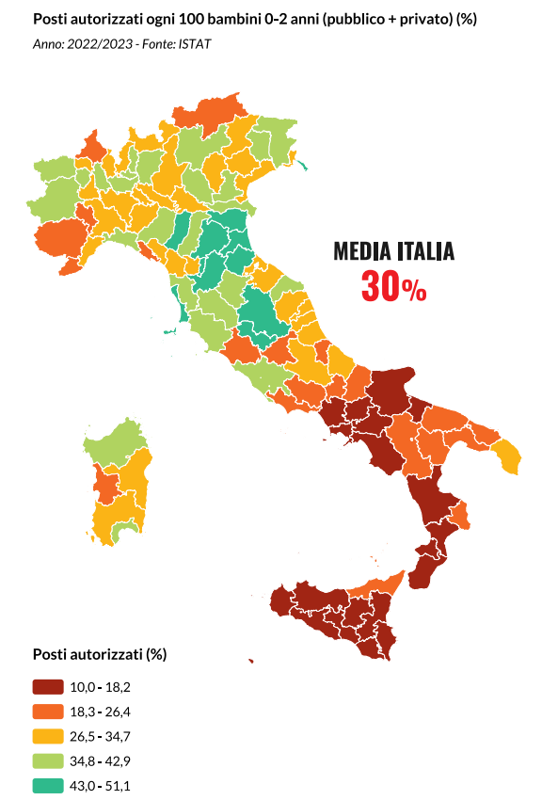

EARLY CHILDHOOD AT RISK The beginning of the story changes the whole story
In Italy*,children from 0 to 3 years old do not grow up with the same opportunities to "develop their potential" in relationships, cognitive, emotional and creative
Territorial, economic, ethnic and cultural barriers create inequalities from birth, which can mark an entire life trajectory
Already at 3 years of age, those who grow up in disadvantaged contexts show evident fragility. And the gap widens, becoming deeper as they enter primary school
The risk of poverty and social exclusion is increasing, especially between the ages of 4 and 6, with peaks in the South, in inland areas, among single-parent families or families with a migrant background
Appropriate policies and integrated, early and targeted intervention are needed to act on:
Quality education from the earliest years
Prevention of frailty through accessible services
Ongoing support to families, taking into account the multidimensional vulnerability of households with children 0–6
*source Atlas of Childhood 0–6 at risk Save the Children 2024

Slide 4
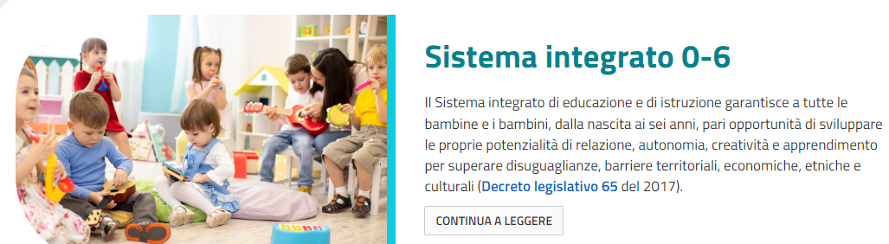
DIP FAMILY POLICIES:National Plan for the Family 2025-27 and National Plan of Action and Interventions for the Protection of the Rights and Development of Developmental Subjects 2025-27
EU and NATIONAL REGULATORY CONTEXT
THE RECOMMENDATIONS
Council of theEU (2019, 2021, 2022): convergence with the focus on the first years of life, to avoid intergenerational transmission of social inequalities, with negative repercussions on educational and school trajectories
MINISTRY OF EDUCATION AND MERIT:Reform on the 0–6 integrated system (2015, 2017) and related funds dedicated to the implementation process aimed at municipalities and schools:www.istruzione.it/sistema-integrato-06
MINISTRY OF LABOUR AND SOCIAL POLICIES: European Social Fund for the implementation of the Child Guarantee (2021): – Axis 1. Prevention and quality services – Action 1. The importance of the first thousand days of life.
National action plan for child guarantee (pangi)

Slide 5
REGULATORY CONTEXT AND SYSTEM CRITICALITIES Education begins at birth
In 2015, the Integrated System of Education and Instruction from birth to six years was established in Italy for the implementation of the 2015 law, implemented by Legislative Decree no. 65 of 2017 (Ministry of Education and Merit). THE EducationAL VALUE IS RECOGNIZED IN THE FIRST THREE YEARS and a RELATED NATIONAL FUND FOR INTEGRATED SERVICES 0–6, but the application of the System remains disregarded.
CRITICAL ISSUES
INSUFFICIENT COVERAGE AND TERRITORIAL DISPARITIES
UNEQUAL ACCESS AND COSTS BORNE BY FAMILIES (for ex. hight fees)
EDUCATIONAL AND SOCIAL POLICIES PERTAINING TO DIFFERENT DEPARTMENTS (LOCAL, REGIONAL, NATIONAL)
FRAGMENTATION OF SERVICES AND UNCOORDINATED INITIATIVES
SPECIALIZED TRAINING NOT INTEGRATED BETWEEN DIFFERENT SECTORS AND PROFESSIONS’

Slide 6
The poli millegiorni: elements of programmatic innovation
In 2022, Save the Children decides to increase its commitment to the Educational CONTEXT by investing in educational services 0–3 years. Early childhood is crucial for the development of cognitive, socio-emotional and relational skills: early education therefore becomes a tool to prevent educational poverty and inequalities. The POLI MILLEGIORNI program is born, to increase the educational offer 0–3 years, within the SPACES of the KINDERGARTEN, a response also to the demographic decline.
After two years of experimentation, elements of INNOVATION have emerged that make the program scalable through local/national institutions and capable of creating skills that generate quality in the services offered in the territories.
Especially: -Taking charge of services by public institutions. From the activation phase, the conditions are created for the initial private funding to be replaced and/or integrated by local and/or national institutions -The technical and methodological assistance promoted by the programme to build institutional networks capable of creating communities: a very important aspect for the quality of early childhood services in every areas in particular in the internal areas -Strengthening of public/private alliances. The involvement of universities and trade bodies (e.g. Regional Council of the Order of Social Workers) promoted with the activation of POLI MILLEGIORNI has contributed to strengthening the integrated training of educators, social workers and health workers. Real and impactful capacity building -Vulnerabilities prevention through cross-sectoral collaboration -The practice of the POLI MILLEGIORNI, as a territorial garrison interconnected with educational, social and health services, allows us to contribute to the innovation of public policies and related implementation plans focused on the first thousand days. The municipalities of the cities where the Poli Millegiorniare located are partners in the program

Slide 7
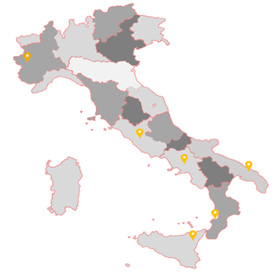
ELEMENTS THAT CHARACTERIZE THE POLI MILLEGIORNI 7 hubs on the national territory
THE POLI MILLEGIORNI ARE TERRITORIAL GARRISONS WITH A HIGH EducationAL DENSITY THAT ARE CHARACTERIZED BY THE FOLLOWING DISTINCTIVE ELEMENTS:
INTEGRATED EDUCATIONAL HUBS WITH HIGH ACCESSIBILITY for fragile families in places without or weak services 0-3
MULTI-DISCIPLINARY TEAMS
LOCATED IN KINDERGARTENS, to give continuity to the educational experience 0-3 and 3-6 years
NETWORKING with actors from the educational, health and social context – PROMOTE CROSS-SECTORAL COLLABORATION
SPECIALIZED TRAINING SPACES for operators, educators and teachers
MONCALIERI
TIVOLI
BARI
CAIVANO
LOCRI &
SAN LUCA
CATANIA
PROMOTE THE RECONCILIATION of work outside the family with the responsibility of care

Slide 8
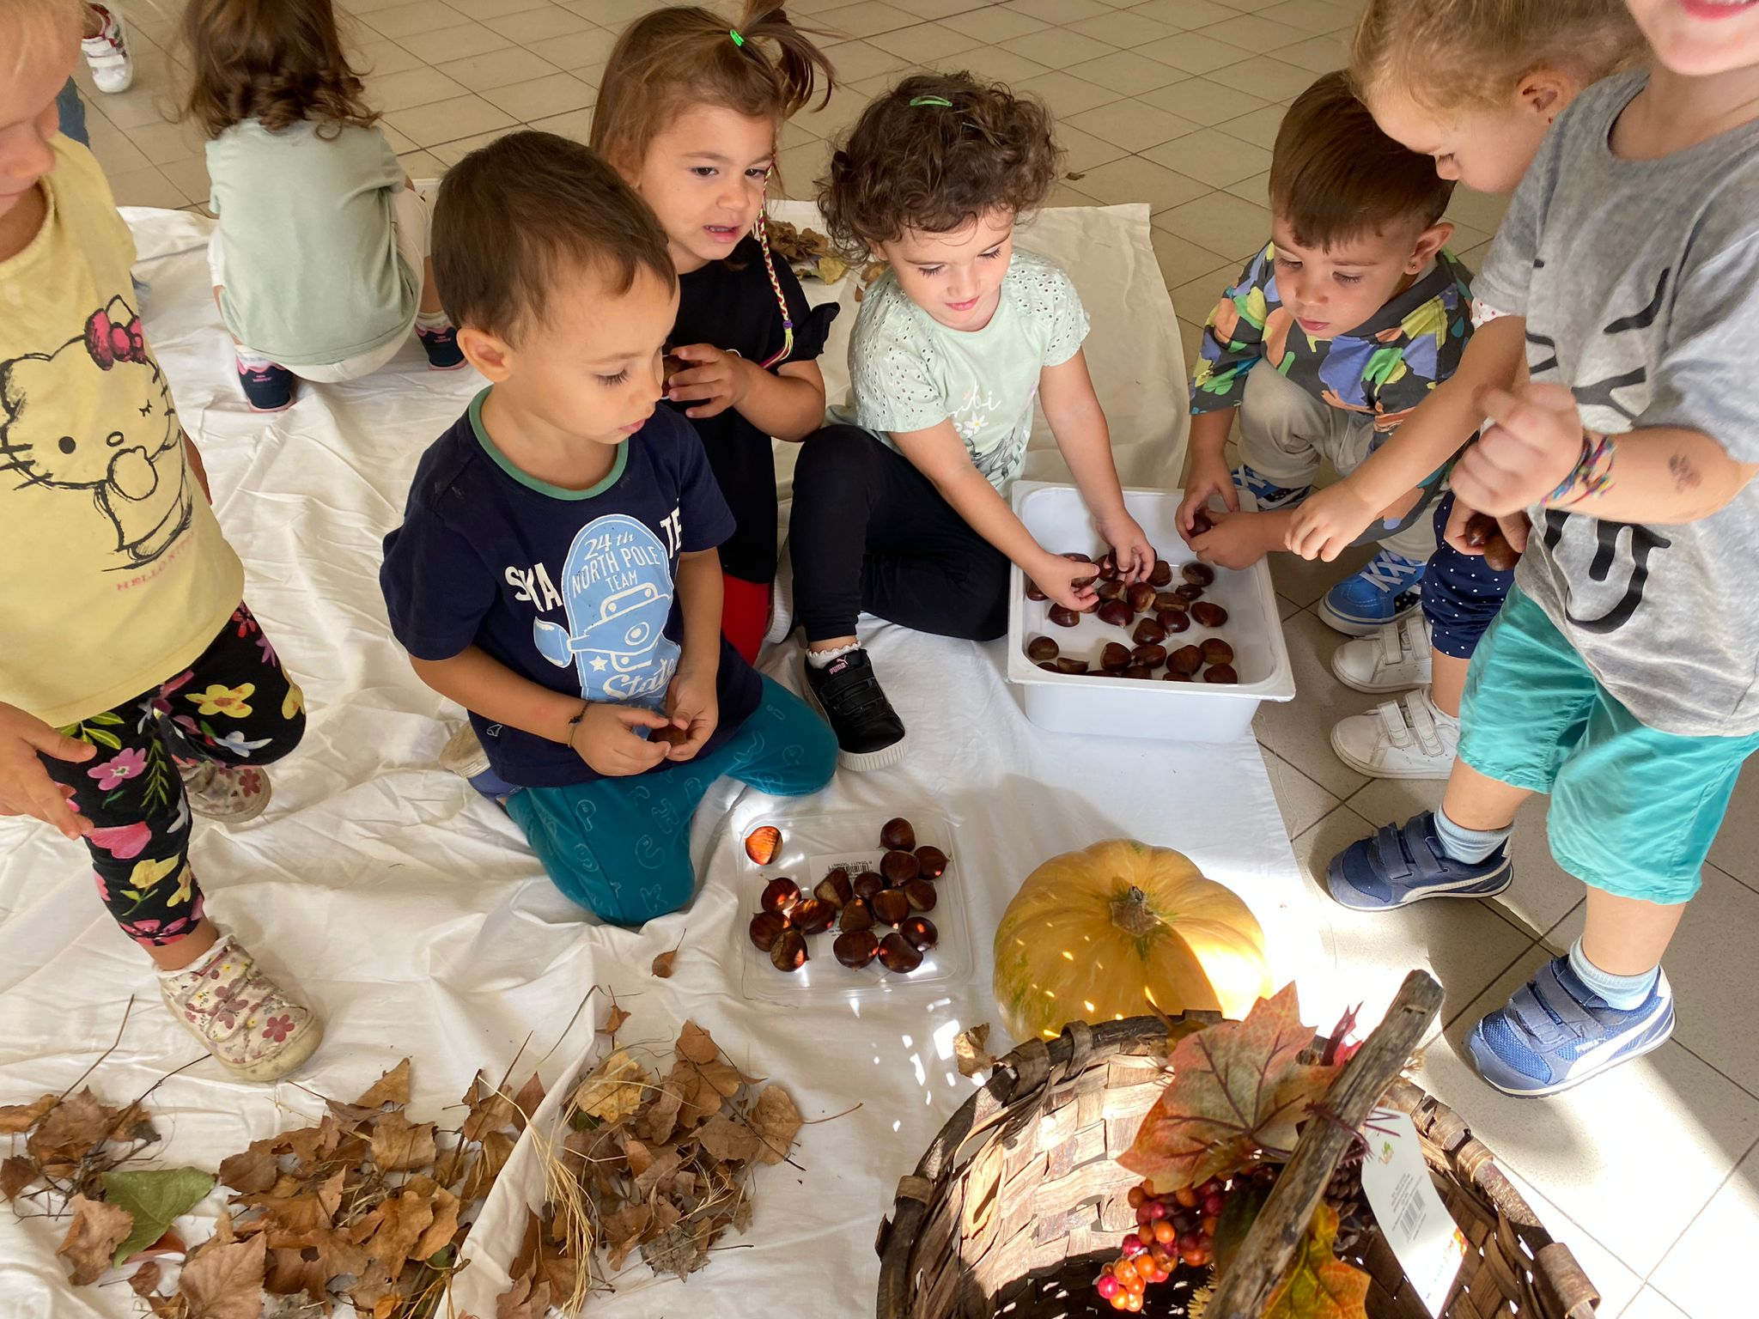
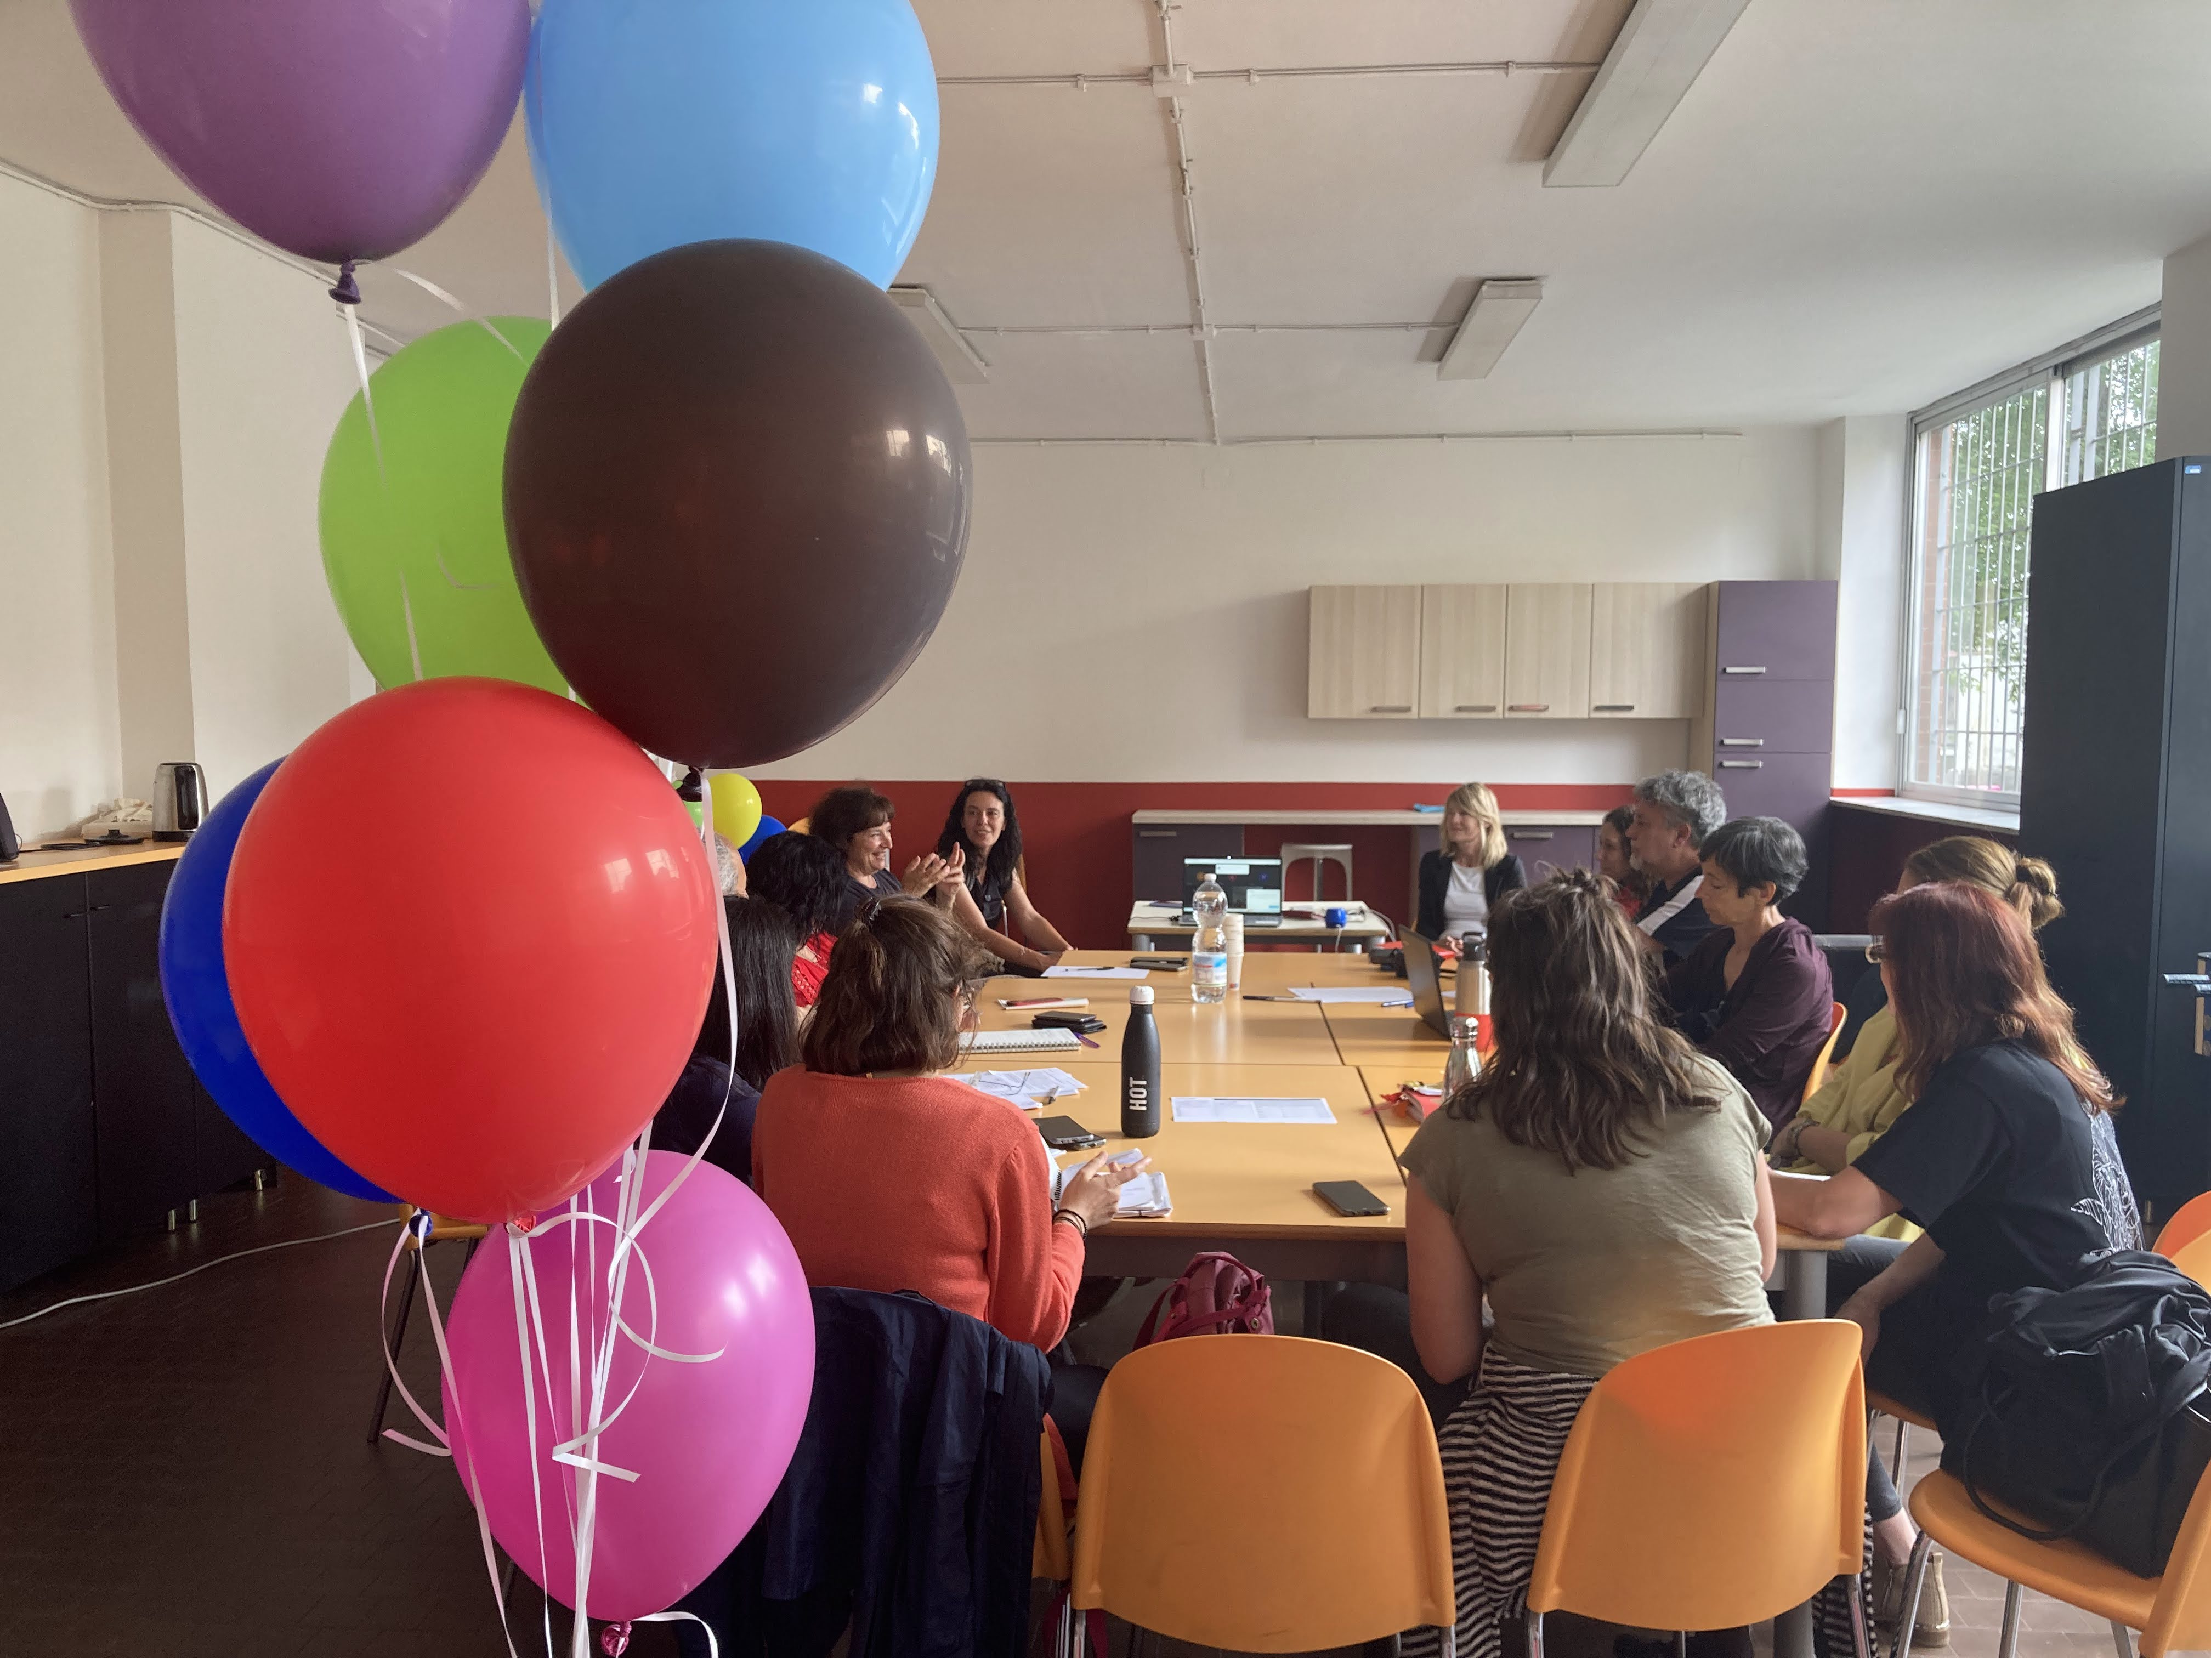
ELEMENTS THAT MAKE UP THE PROGRAM Three macro actions
EDUCATIONAL SERVICES for the enhancement of the cognitive, emotional and social skills of children
Supplementary educational service 18-36 months in custody, in the morning, throughout the school year Cultural, artistic, sports workshops 0–6 children and parents together Outdoor education, especially in the summer season, and free summer camps
FAMILY AND PARENTING SUPPORT SERVICES’
Service orientation - definition of skills and job search, emotional support, interviews psychological support; care skills (basic necessities, medical visits, etc.) – responsive parenting paths; Advice for specific needs (fiscal, administrative, legal, health)
INTEGRATED SYSTEM ENABLEMENT ACTIONS 0–6 Activation of territorial coordination with Municipalities, Regions and educational and socio-health and private social services Training of operators, co-planning with local and national actors Child Safeguarding: Training courses and policies with infant-toddler centres and preschools

Slide 9
The POLI MILLEGIORNI: legislation in practice
THE PROGRAM makes use of a qualitative evaluation of processes, curated by the University of Bologna. There are 4 axes of observation:
The POLO MILLEGIORNI intervenes right where the system stops:
Concrete attention to the "different vulnerabilities", through inclusive access criteria, tailor-made interventions and flexible organizational methods.
Not only the right to quality education 0–3, but educational and social care of the family unit. We support education with concrete support for mothers and fathers, promoting spaces for meeting and socialising.
Education 0–3 is not only a service, but an engine of social cohesion
A space that invests in responsive parenting, creating bonds of trust between operators and families, i.e. a sense of belonging and shared responsibility.
An active territorial direction to intercept fragility at an early stage and give integrated responses
Coordination between public and private actors and with social, health and education services.
Accessibility to services offered
Family participation
Quality of educational services
Inter-institutional networks to support local governance processes

Slide 10
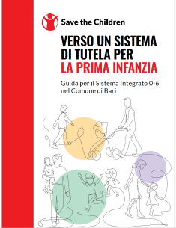
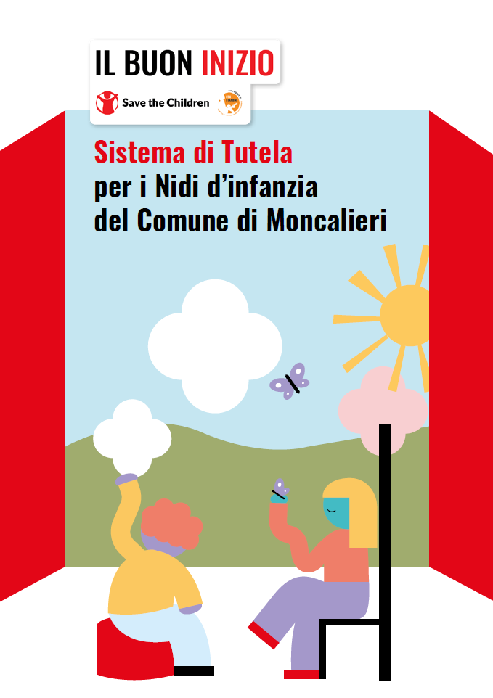
THE POLI MILLEGIORNI promoters of a culture of protection and safety in the nurseries and kindergartens involved
Developing a Protection System for the nurseries/preschools involved in the intervention of the PoliMillegiorniaims to prevent and minimize the risk of inappropriate conduct that may harm the rights, first and foremost the right to protection, of girls and boys and to provide the educational reality in question with every possible measure to prevent any inappropriate conduct by any adult in a position of trust, to clearly and effectively report and respond to any concerns. A process that involves: - Training of educational personnel - Composition of the working group (control room) - Development and adoption of Protection policies
Content Hub:CH1304412

Slide 11
An innovative and sustainable model for the PoliMillegiorni
HOW DOES THAT WORK
Save the Children internal resources launch the Hubs→ in 2-3 years the activities are progressively integrated into the local institutional system
Save the Children’s role is to manage the start-up and support the transition to institutional management, ensuring continuity and quality of services
EVIDENCE
2 out of 7 already taken care of by the municipalities. Not all poles can be taken care of by institutions in a time frame of 3-4 years: 60% target (also thanks to the focus on the 0–6 age group linked to birth policies)
Growing institutional and regulatory recognition at local and national level
The model is attractive to private donors (especially foundations) and the actions of the program favor the integration of public and private funds
Result
A sustainable and systemic “good practice” that, thanks also to cross-sectoral collaboration, contributes to strengthening services for children aged 0–3 in Italy

Slide 12
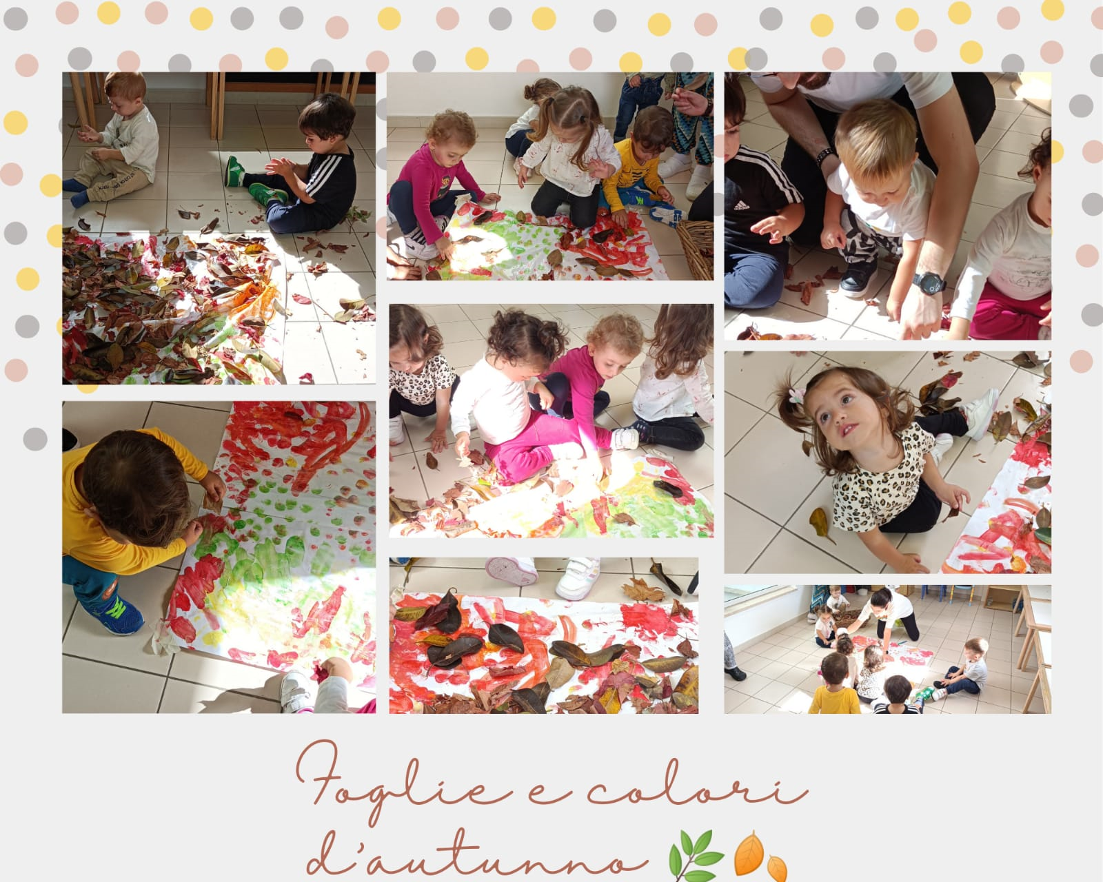
Thank you!

