Slide 1
Rethinking the boundaries of early childhood education and care
Breaking Silos, Building Futures: Policy Innovations for Integrated Family and Child Support
Elizabeth Shuey
OECD Directorate for Education and Skills, Early Childhood Education and Care Team
25 September 2025
COFACE Families Europe and Odisee University Conference

Slide 2

Starting Strong VIII
Part I. Overview and methodology
Part II. Inequalities in early childhood: drivers and mitigating processes
Part III. Supporting equity and inclusion in early childhood education and care (ECEC)
Part IV. ECEC policies with a last impact
Chapter 10. Co-ordinating early years policies and services

Slide 3




Early childhood education and care (ECEC) is a cost-effective way to close achievement gaps before they widen
Hypothetical scenario
Effect of ECEC on individual outcomes and performance gap:
Short-term gap
Long-term gap
Initial gap
Inequalities reduced over the life cycle through ECEC
Age 7
Age 30

Slide 4
Combine investments for a more consistent policy approach
Figure 4.4
Public spending on family benefits and education, OECD average, 2019

Slide 5







A policy roadmap for ECEC to support equity and inclusion with lasting impact:
1. Reduce gaps in participation in ECEC
2. Support meaningful interactions between children and ECEC staff
3. Make ECEC inclusive for all children
4. Connect ECEC services with families, schools and communities
5. Improve governance and funding for early years policies
Combine universal and targeted approaches
Align ECEC with the broader early years policies

Slide 6








Early development occurs in key stages amidst broader social and economic changes
Reproduction of inequalities
Declining time for play
Increasing income inequality

Slide 7
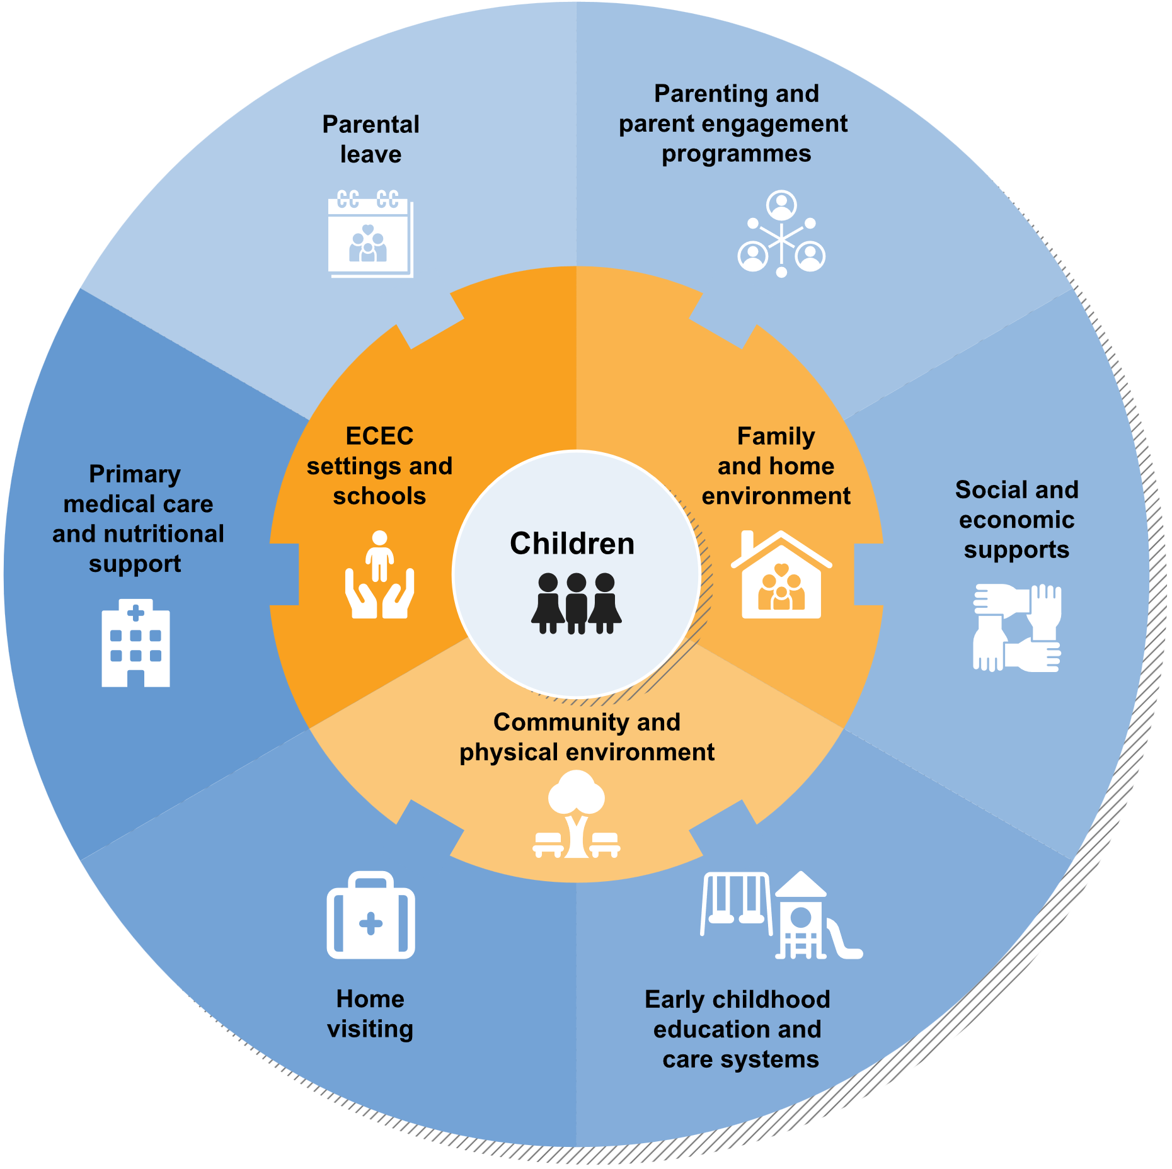
Align ECEC with the broader early years policies
Figure 4.1
Multiple types of ECEC, together with…
Parenting and parent engagement programmes; Home visiting
Primary medical care and nutrition support
Schools
Family leave
Employment and training supports for parents
Welfare benefits and tax relief
Housing and urban planning

Slide 8
Different types and degrees of policy and service co-ordination are possible, including within the ECEC sector
Continuum of alignment
Horizontal integration
Fragmentation
Co-operation
Collaboration
Co-ordination
Integration
Central government
Ministry of education
Ministry of health
Ministry of employment
Ministry of social affairs
Local authorities
School board
Municipal health dept.
Employment office
Vertical integration
Municipal social policies
Providers and non-governmental organisations
Public ECEC
Schools
Employers
Unions
Private ECEC
Home-based ECEC
Charities and foundations
Parent organisations
Children and families

Slide 9
Rethinking the boundaries of ECEC
Focusing on parenting and parents
Building on community-based programming
Extending the age range
Building climate resilient, family-centered spaces
Developing integrated data systems
Implementing national oversight through quality frameworks and funding for co-ordination

Slide 10

Focusing on parenting and parents
ECEC programmes can support parents to foster children’s well-being and early learning, amplifying and sustaining children’s positive experiences in ECEC. ECEC programmes can offer…
Evidence-based parenting skills programmes
Educating parents about child development
Opportunities for parents to connect with staff and with one another
Home visiting
Training or employment services
In Iceland, service co-ordinators support parents to navigate across various service sectors.

Slide 11

Building on community-based programming
Service hubs are one strategy to address barriers to participation in ECEC and facilitate co-ordination across service providers.
Health services can be a core component of hubs due to widespread availability and trust
A “no wrong door” approach ensures families find an appropriate suite of services
The specific services associated with hubs are highly adaptable to local contexts
Including a core set of services can support public understanding
The Sure Start programme in the United Kingdom offered a suite of co-ordinated services and has inspired the new Best Start Family Hub model in England.

Slide 12

Extending the age range
Cross-sector co-ordination can extend aspects of ECEC from the pre-natal period through elementary school
A focus on parents supports co-ordination of pre-natal services with ECEC programming
Integration of ECEC for younger children and preschool-aged children can reduce inequalities and inefficiencies in the system
Strong co-ordination between ECEC and primary school is critical for quality for children at both stages
The non-formal education sector in Luxembourg has a unified curriculum for children ages 0 to 12, from their first entry into early childhood structures through their out-of-school time in elementary schools.

Slide 13

Building climate resilient, family-centred spaces
Young children learn through movement
They are particularly vulnerable to the effects of climate change on the built environment and access to outdoor play areas
Designing urban spaces with and for families can support opportunities for learning beyond the walls of ECEC
Connections between ECEC and other actors in the community supports environmental awareness in ECEC curricula
Canada funds local projects to explore, test and develop tools, models and programmes to build resiliency in children through outdoor learning and play.

Slide 14

Developing integrated data systems
Data sharing across sectors serving children and families is a policy priority
Protecting individual data and the burden of data collection and entry can be hurdles
Logic models articulate which data are needed and by whom to deliver desired outcomes
Whole-of-government approaches underpin data governance and infrastructure
The Restacking the Odds initiative in Australia has developed a set of “lead indicators” that programmes can use to collect and share better data on their services.

Slide 15

Implementing national oversight through quality frameworks and funding for co-ordination
All components of co-ordinated programming must be of good quality to achieve desired results
Multi-sectoral quality frameworks provide mechanisms for prioritising co-ordination and a common language for programmes to use
Support balance between local autonomy and consistent oversight and quality, as well as funding
Provide a shared vision and “glue” that holds together co-ordinated services

Slide 16
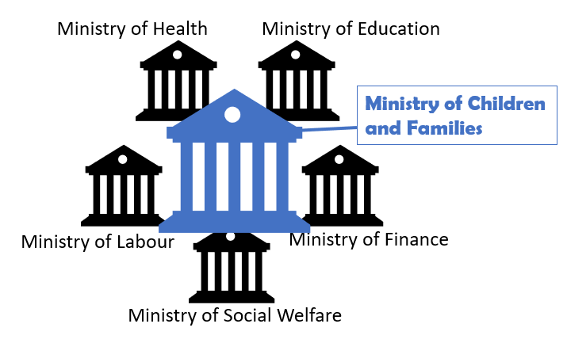
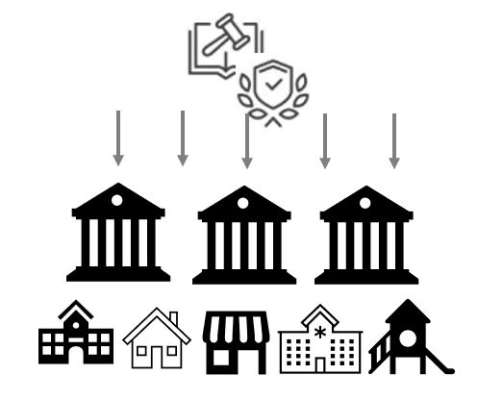
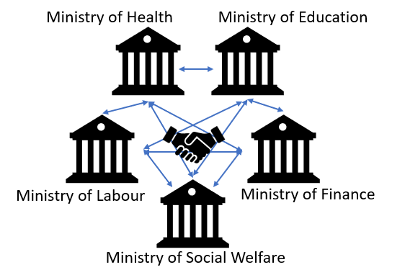
Governance for co-ordinated services throughout childhood: Several models exist
1
1) A dedicated national authority for children and families
Japan’s Children and Families Agency (established 2023)
2) National strategies and legislation for co-ordinated early childhood efforts
2
Colombia’s De Cero a Siempre (since 2011)
Ireland’s First 5 Strategy (2019-2028)
Australia’s Early Years Strategy (2024-2034)
Iceland’s Prosperity Act (since 2022)
United States’ American Rescue Plan Act (2021)
3
3) High-level co-ordination across traditional governance structures
France’s Les 1000 premiers jours (since 2020)
Integration of ECEC and health data in Germany during the COVID-19 pandemic

Slide 17
Thank you for your attention!
www.oecd.org/en/about/programmes/early-childhood-education-and-care-ecec
elizabeth.shuey@oecd.org

