Slide 1

Expanding the boundaries of ECEC
Géraldine Libreau
DG Education, Youth, Sport and Culture,
Unit B2. School education and multilingualism
Notes:
> • The EU vision for ECEC, which serves multiple purposes > • The Child Guarantee, which tries to break silos
• The 2019 Council recommendation and the EQF, with a focus on access + involvement of parents + integrated work > > • The recommendations by the ECEC WG on > • working with (vulnerable) families > • integrated work > • involving families in monitoring and evaluation of quality > • staff training and efficient leadership

Slide 2
Our vision: A high-quality inclusive ECEC system serves multiple purposes
Children’s cognitive, social and emotional development
European Education Area Strategic Framework, incl. targets for participation (96% of children >3) and the ECEC Working group (2021)
Council Recommendation on ECEC: the Barcelona targets for 2030, incl. targets for participation (96% of children >3; 45% of children <3); part of the Care Strategy (2022)
Parents’ employment / Gender equality / Work-life balance
Council Recommendation establishing a European Child Guarantee, promoting effective and free access to ECEC of vulnerable children (2021)
EU Strategy on the Rights of the child (2021/2022)
Fight against poverty and social exclusion
Council recommendation on high-quality ECEC systems, incl. the European Quality Framework (2019)
Action Plan for Basic Skills (2025)
0-6 years-old
EU funding
Erasmus+
ESF+
Technical Support Instrument
Recovery and Resilience Fund
Horizon2030
Policy cooperation
Research and data monitoring

Slide 3
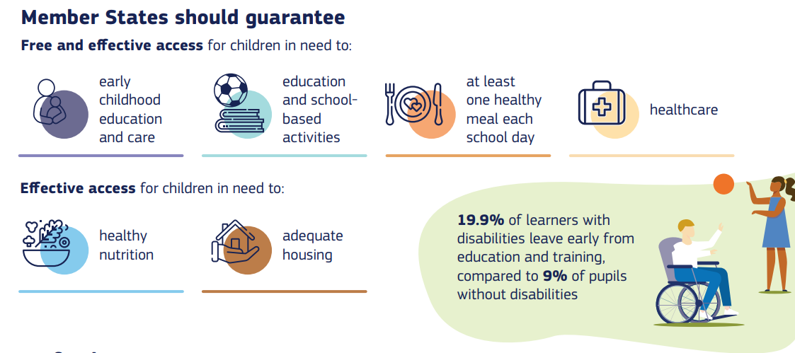
Child Guarantee
National coordinators and actions plans

Slide 4
2019: aiming to improve quality of ECEC systems
Council recommendation on High quality ECEC systems
Incl. the EU Quality Framework for ECEC
QUALITY
Access
Curriculum
Staff
Monitoring and evaluation
Governance and funding
Notes:
focus on access + involvement of parents + integrated work
• The recommendations by the ECEC WG on > • working with (vulnerable) families > • integrated work > • involving families in monitoring and evaluation of quality > • staff training and efficient leadership

Slide 5


European cooperation on ECEC
ECEC is the first step of the lifelong learning ladder
EEA ECEC Working group
Chaired by the European Commission
Country representatives (EU 27 + candidate countries + NO + IS)
Stakeholders
European and international agencies
Experts
Main focus since 2018:
Inclusion / Access
Staff
Monitoring and evaluation

Slide 6

Approaches, strategies, examples and resources
Based on research findings and policy recommendations
For
National and local decision-makers
Employers
ECEC staff
Education and training providers
Trade unions and other social partners
Universal policies and practices which benefit ALL children
Additional, more specific measures for
Children with disabilities
Children with a migrant background
Roma children
Other hard to reach children (in jail, in hospital, in lockdown)
https://op.europa.eu/s/oMFk
Notes:
The Commission’s expert group worked for 2 years, looking at
recent research findings,
policy recommendations (e.g. from the Council recommendation, but also listening to stakeholders)
Policy and practice experiences presented by WG members (=> national policies, cities’ approaches, staff experiences…)
It can be useful to various groups …

Slide 7
Inclusive practices for the benefit of all children
Integrated work
Working with families
Facilitating transitions
Notes:
The Toolkit also looks at practices which benefit all children and families. It considers in particular:
the benefit for ECEC staff and institutions to work with other services that support the interests of children and families; (what we call integrated work)
the need to work in close cooperation with families;
strategies to facilitate transitions – between home and ECEC institution, between ECEC institutions, or between ECEC and primary school.

Slide 8
Integrated work
ECEC provision should support close cooperation with other services that support children and families, to answer their needs more adequately.
Need to:
Create supportive conditions for such cooperation at the national and local levels
Ensure that financial incentives and expectations for ECEC providers support integrated working
Include integrated working in professional and leadership training
Notes:
Many examples and resources included in the toolkit to develop such ways of working

Slide 9
Working with families
Communication
Integration
Decision-making
Flexibility
A MUST!
Working together in a child-focused perspective
Children’s well-being
Children’s learning development
Etc.
Notes:
1. Working with families is essential for inclusion for many reasons….
2. It can be done in many ways (see list on p. 90 of toolkit), but they all focus on 4 principles
Improve communication
Integrate parents in ECEC activities
Develop participation in decision-making
Flexibility (e.g. for opening hours, on the use of mother tongue, on family diversity…)

Slide 10
Facilitating transitions
From home to ECEC
From ECEC
to primary school
Between ECEC institutions
Ensures continuity and progression in children’s learning and development
Notes:
Need to support children and families to go through all transitions phases – particularly important for children from vulnerable backgrounds

Slide 11


European ECEC WG
2018-20
Toolkit for inclusive ECEC
How to recruit, train and motivate well-qualified ECEC staff?
2022-23
Monitoring and evaluating quality in ECEC: four thematic reports (incl. M&E to support inclusion, and how to involve children, families, staff and stakeholders)
2024-25
ECEC Leadership (incl. leadership for inclusion, integrated work, and focus on ECD)
https://wikis.ec.europa.eu/display/EAC/ECEC+Documents

Slide 12
Thank you
© European Union 2025
Unless otherwise noted the reuse of this presentation is authorised under the CC BY 4.0 license. For any use or reproduction of elements that are not owned by the EU, permission may need to be sought directly from the respective right holders.

Slide 14
Research and data monitoring

Slide 15

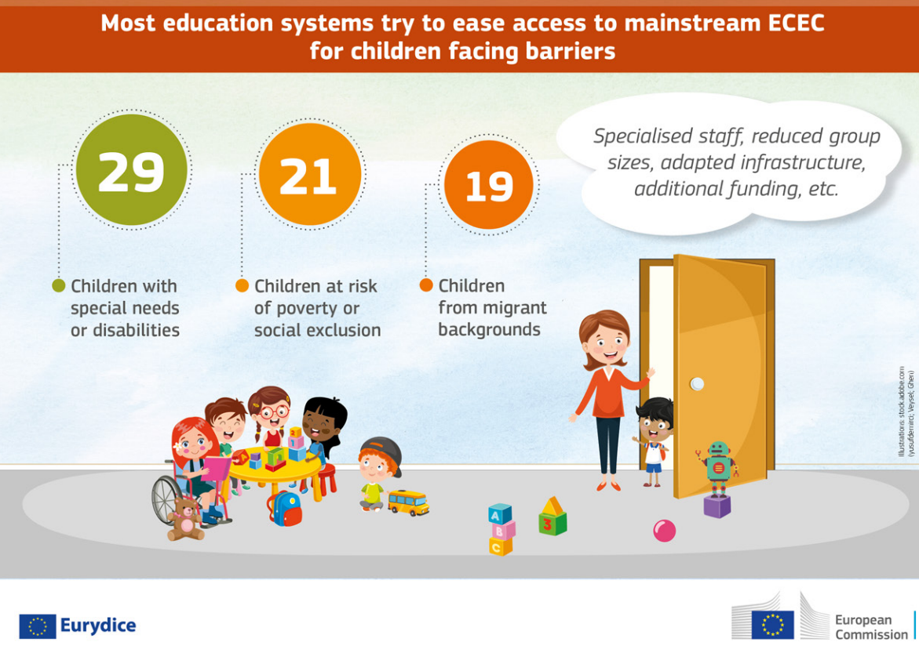
https://eurydice.eacea.ec.europa.eu/publications/key-data-early-childhood-education-and-care-europe-2025

Slide 16

Recommendations for CPD of ECEC staff working with multilingual children and families
Follow a step-wise design, in which the desired outcomes for multilingual children and families are defined in advance of selecting the targeted practices and CPD delivery modes.
Be tailored to the needs and capabilities of professionals. It should be adapted to specific contexts, and a range of practices and delivery modes should be put forward.
Emerge from a positive vision of multilingualism and through collaboration with parents. It should draw on scientific knowledge, and also work well with existing policies.
Be embedded within a sustainable, system-based policy on staff professionalisation.
Be integrated into an ongoing focus on quality within ECEC, and take into account all dimensions of the European Quality framework for ECEC.
https://education-socioeconomic-experts.ec.europa.eu/publications/analytical-reports/working-multilingual-children-and-families-early-childhood-education-and-care-ecec_en
Notes:
This report explores how continuous professional development (CPD) can support ECEC professionals in acknowledging and welcoming multilingualism in ECEC, as well as in fostering language development of multilingual children. It synthesises state-of-the-art knowledge on (early) multilingualism and CPD of ECEC-professionals and draws on two case studies and a consultation of experts to formulate research and practice-based recommendations on how to develop high-quality CPD to support ECEC professionals in their practices in relation to multilingual children and families.

