Slide 1

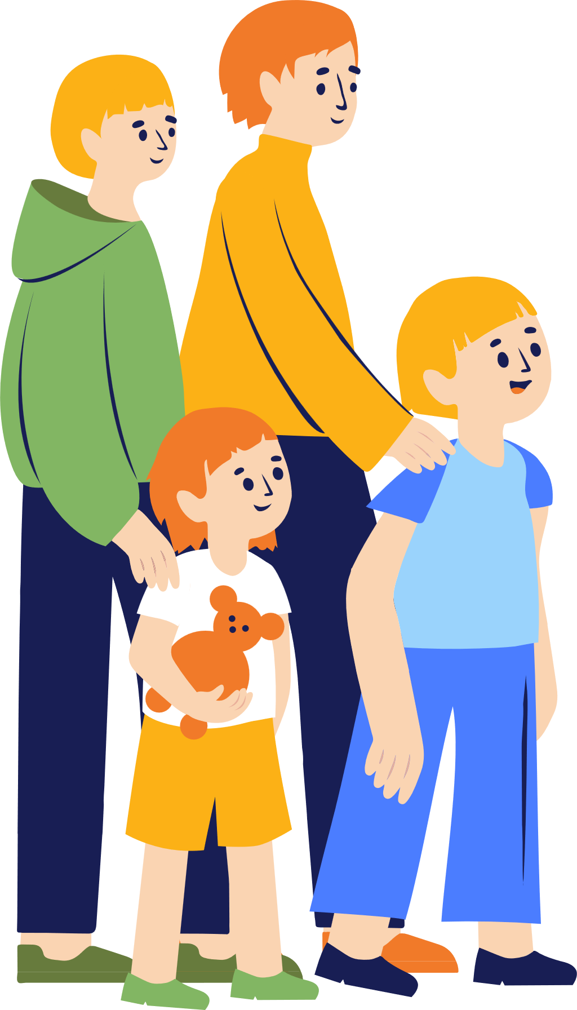
Integrated Support for Families
Hanna Vseviov
Vice Chancellor
25.09.2025, Brussels

Slide 2






General data about Estonia
Population 1.4 million
Tallinn
Number of children 260 000/19%
79 local municipalities
95% of households have internet connection
Nr 1 in EU in the share of online public services (DESI Index 2022)
Notes:
Digital Economy and Society Index

Slide 3
Organizational model
Digital models

Slide 4




Crucial pieces of the support system
Notes:
There are crucial pieces that need to come together in order to make up a well-functioning support system

Slide 5
Integrated support system
Health
Wellbeing
Education
Safety

Slide 6


A comprehensive system for ensuring the child well-being
Prevention Council
The Minister of Education and Research
The Minister of Justice
The Minister of Social Protection
The Minister of Health
The Minister of the Interior
The Minister of Culture
MONITORING
SUB-WORKING GROUPS
Convention on the Rights of the Child
Estonian Child Guarantee progress
Child welfare working group
STATE LEVEL
Welfare Strategy 2023-2030
Children and families program
State budget
The Social Insurance Board
LOCAL LEVEL
Notes:
Complex states that we have nowadays.

Slide 7
3 examples of digitalization in family support
Family benefits – proactive public service (live since 2016)
Birth of a child – life event service (being finalized)
Child with a health probleem – life event service (in progress)
Notes:
Aim is to decrease the fragmentation of support

Slide 8
1. Proactive payment of family benefits
Front-office
No applications or paperwork – benefits are calculated automatically
Quick overview and comparison of parent allowances
Easily assign who receives the benefit
98% customer satisfaction
Back-office
Data exhange between 4 state information systems (health, population, taxes, benefiits)
Low risk of mistakes – universal family benefits + good data quality
More time to deal with unique cases (parental disputes)
Notes:
2016. Population Register, Health Information System, Tax and Customs Board Information System, Social Insurance Board Information System
Only one public service, but life is more complex. Bound to one public service.

Slide 9
2. Life event service – birth of a child
14 life event services.
An event service compiles several services related to the same event into a single service for the user.
Front-office comes together to the state portal Eesti.ee, each estonian has a state email address.
Information service + data sharing service
Proactive EE government services – YouTube
Notes:
Aim is to decrease the fragmentation of support

Slide 10





A child in need → difficult process for the whole family
Notes:
Support system tends to look like a labürint for families, especially when there are some specific needs in the family. We started to look what are the possibilities to make it more easy. Kuna eri avalikke teenuseid ja inimese heaolu tahkusid koordineerivad paratamatult erinevad ministeeriumid ja asutused, siis võtsime eesmärgiks mitte lahendada kõiki back-office-i killustatusega seotud küsimusi, vaid tagada fron-office-i võimalikult loogilise ja inimkeskse ülesehituse

Slide 11










Goal → supported and proactive process from the very beginning
Notes:
Guidlines

Slide 12
Automatic sharing of data of children with disability (2023)
Front-office
Parent/child turns to the doctor and also applies for the disability assessment.
No need to apply for services provided by the municipalities.
Municipalities can offer support already connected to the child`s situation.
Easy possibility to refuse from provided help.
Back-office
Automatic data exchange between 3 databases.
Key child info (type and severity of disability) sent daily to child welfare specialist`s desktop, updated every 24h.
Specialist has to contact parents within 10 working days and offer support.

Slide 13
Automatic sharing of data of children with a health problem (2025-2026)
Front-office
Parent/child turns to the doctor and gives consent of data sharing.
No need to apply for services provided by the municipalities or state.
Easy possibility to refuse from provided help.
Personalized dashboard on eesti.ee - allows to see individual info on rights across municipalities and state and other information.
Back-office
Diagnosis triggers transfer: Health Info System → Social Services and Benefits Info Systems
Support needs (not the diagnoosis) are sent to the municipality.
Municipality contacts family to ask if they want assistance, consent recorded in STAR system.
One-click submission from municipality to national system – disability application automatically generated, reviewable by the person.
Data sharing allows to provide personalized info.
Notes:
Conditions requiring permanent support. The conditions are defined by Ministerial Regulation

Slide 14
3. Life event service – child with a health problem
https://www.figma.com/proto/vY1qmfJyaXIGn94iLGlKvl/Muutumatu-seisundiga-laps?node-id=1317-12611&starting-point-node-id=1313%3A11084

Slide 15
Preconditions & challenges
High overall level of digitalization
Trust in government institutions
Good digital infrastructure that allows safe data exhange of personalized data – X-Road, ID card
Quality of Data
Balance between data protection and proactive support
Division of policies between LGs and central government/state
Balance between fancy solutions vs basic IT infrastructure

Slide 16


Thank you!
Anastasia Shuraeva

