Slide 1

Innovations for equality of child, youth and families in Finland Breaking Silos and Building Futures Coface –conference 25.9.2025 Maria K. Aula Chair of the Board, Central Finland Wellbeing County Vice Chair – ITLA childrens foundation

Slide 2
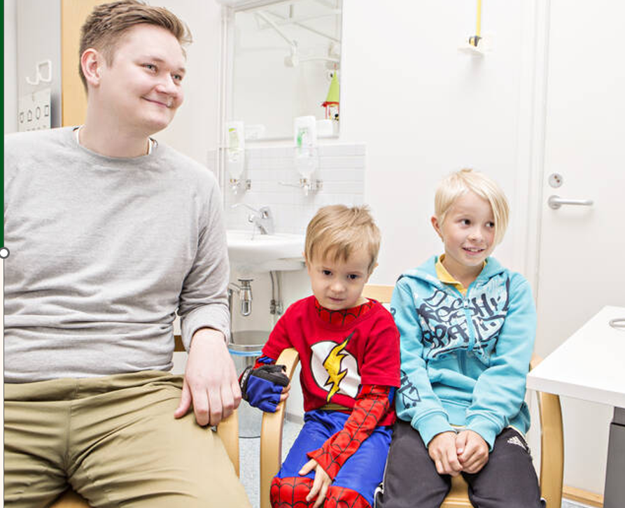
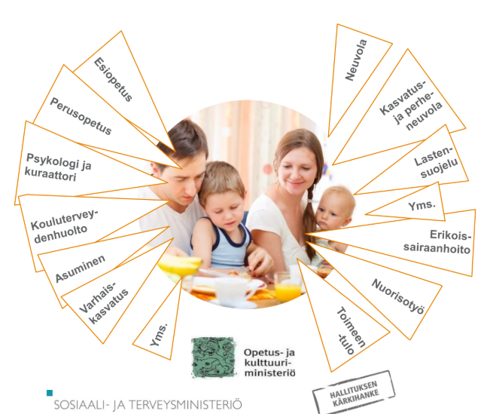
What kind of inequalities?
Inequalities in living conditions – family life, school relationships, income
If we take 100 children of age 10-11 (school health study 2025)
8 of them can hardly ever talk with their parents about their problems
9 have experienced violence by their parents at least weekly
9 are bullied at school weekly
4 feels him or herself often lonely
About 12 % of all children live in poor family
Inequalities in availability and quality of social and health services when they were provided by over 300 municipalities (before 2023)
Mental health (basic level) services lacking
Very scattered service system (budgeting, customer data, physical places, managing, planning)
R&D and development resources very scarse

Slide 3

Broad integrative child and family services reform program was implemted nationally, regionally and locally in Finland during 2015 – 2023 (LAPE) Both social and health and education + youth ministries quided the program of 50 mill euro Implementation by municipalities an regions in whole Finland + NGOs and parishes. - Holistic approach – focus on improving the growth environment of children by integrative means Close human relationships matter! Empowering all kinds of families. Child rights based

Slide 4
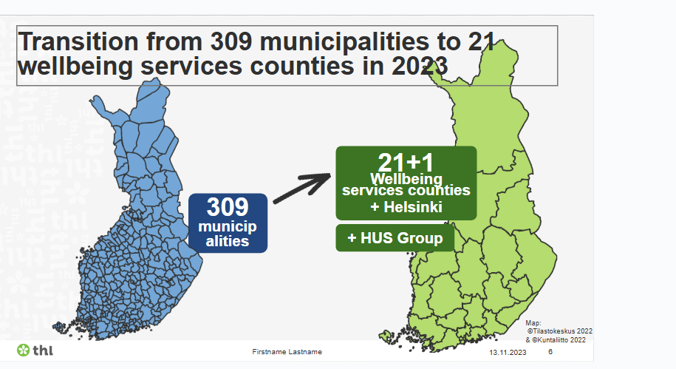
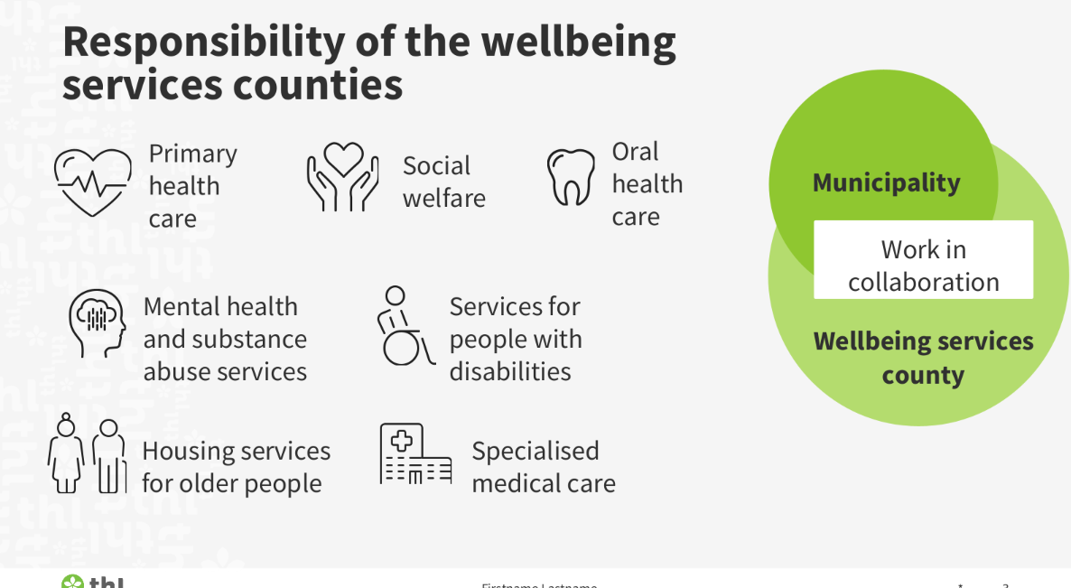
Social and health services reform introduced new division of labour between municipalties and counties. Before 2023 the municipalities organized both education and social + health.
Reform has already had positive impact on equality.
How to ensure integration in child, youth and family services with divided responsibilities?
Participation and democracy
Responsibilities of municipalities
Early education and care
Comprehensive school
Youth work, culture, sports
Promoting of health and wellbeing
Housing and environment
- Adult education
INTER
FACE
of low threhold services:
FAMILY CENTER
Promoting health
and wellbeing
Coordination

Slide 5

How do we integrate child and family services?
Family Center – structure to gather low threshold basic social and health services for children and families – collaboration with ECEC, NGO, parishes locally
Ask for help ! Digital ”button”
you do not have to know which professional you would need to consult – we contact you.
Evidence based methods - psychosocial work, mental health, parenting
implementation supported by ITLA foundation
Let´s talk about children! – Provides common language and evalution for a network to support children. Solurion oriented. Professionals and close ones.
The Incredible Years (parenting support, handling groups)

Slide 6

How do we integrate child and family services?
Preventive work – promoting wellbeing and health .- municipalties and counties and NGO´s together
Common plans to promote children wellbeing (legislative)
Negotiations annually between municipalities and county
Agreements on networks and other structures (voluntary)
Leadership training programs provided by ITLA foundation (Building a good childhood -program)
New tools for plannning and budgeting, follow up
Child Budgeting : analyzing the use of resources across t (e budgets of municipalities and wellbeing service regions, in a previous budget year.
Child impact assessment of decisions
Children and young people as experts of experience,
Adults learning from children, and young people

Slide 7
What did we learn? Integration= child and family friendly
Sometimes better integration needs reformed legislation etc.
But more often the reason for lack of integration is in different working cultures, concepts of child and family and the ”way we always used to work”
We need to reform the education and training of professionals in order to gain more child – and familycentered services
universities and schools of applied sciences should integrate already during studies of teachers, nurses. Social workers, doctors
Hardware (structures) are not enough – we need software – new ways to work: re-educating both leaders and professionals and create a common vision on child and family friendly municipality, region and Finland.
Funding should promote integrations – risk of suboptimizing exists. Counties are funded by state taxes. Municipalities by local taxation.

Slide 8
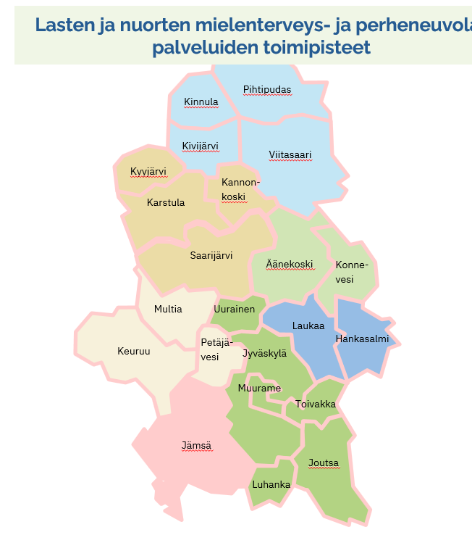
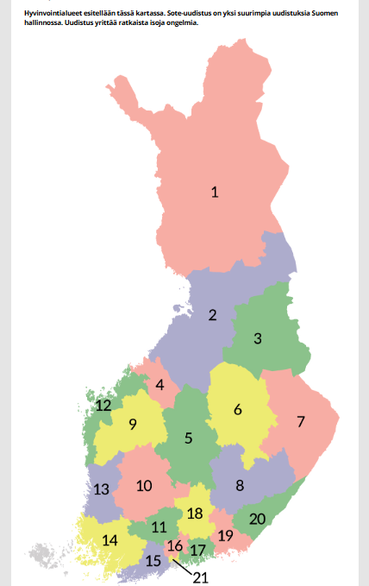

NEXT: Middle Finland Wellbeing services county is partnering with ITLA – childrens foundation with place-based, community oriented reform process of services (bottom - up)
273 000 inhabitants in 22 municipalities
5200 NGOs

Slide 9
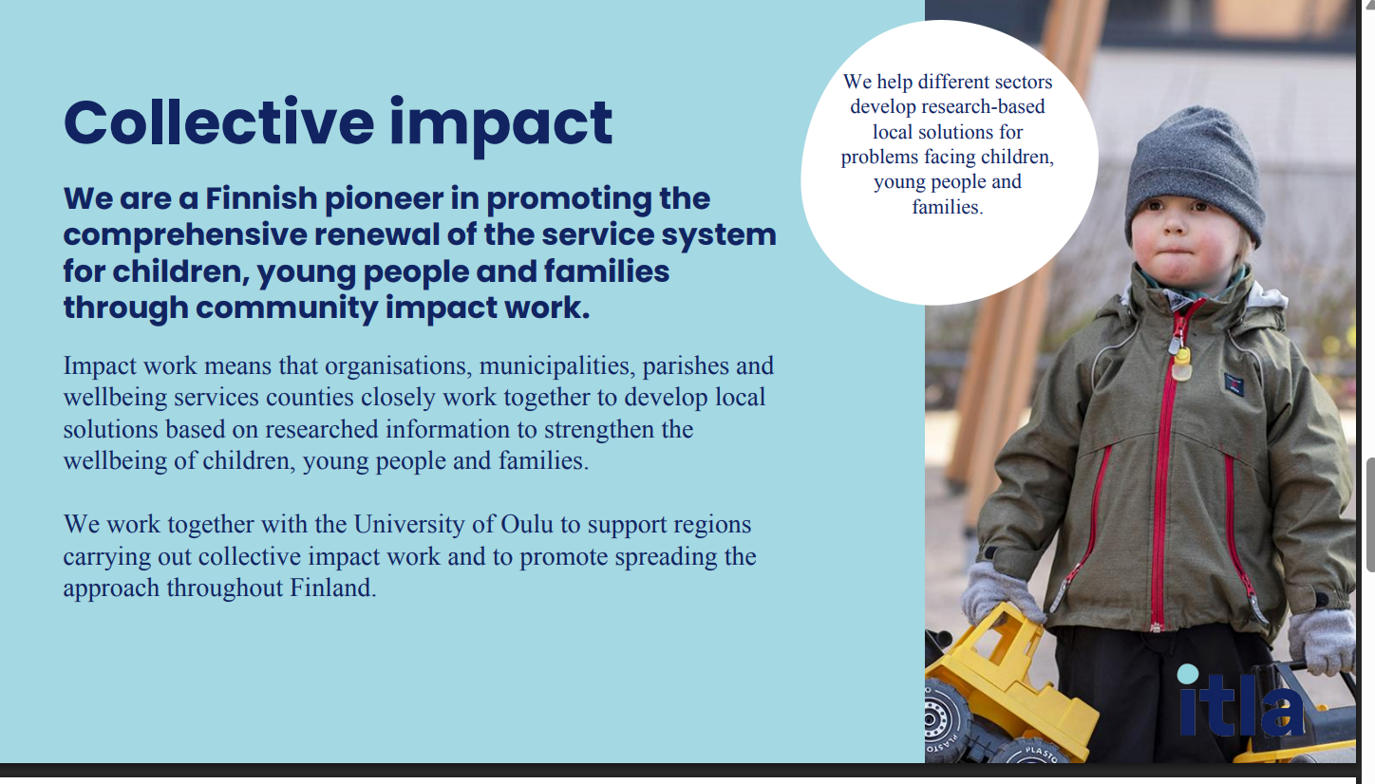
ITLA FOUNDATION
Continuity: Family Center is the key structure in collective impact – approach.
LONG ENOUGH
EARLY ON
ALLTOGETHER

Slide 10
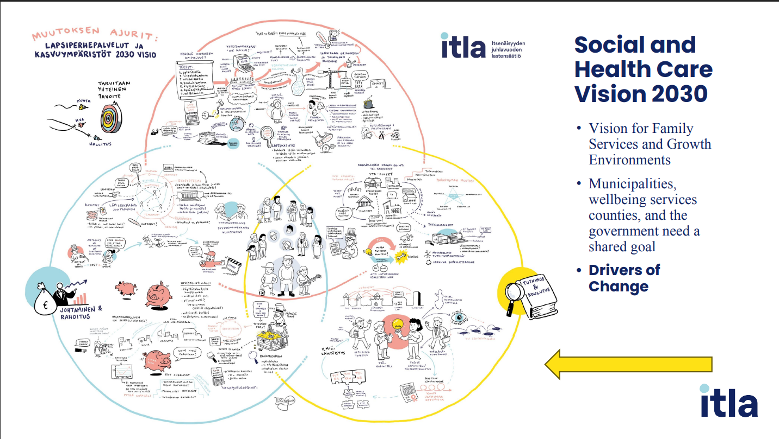

Slide 11
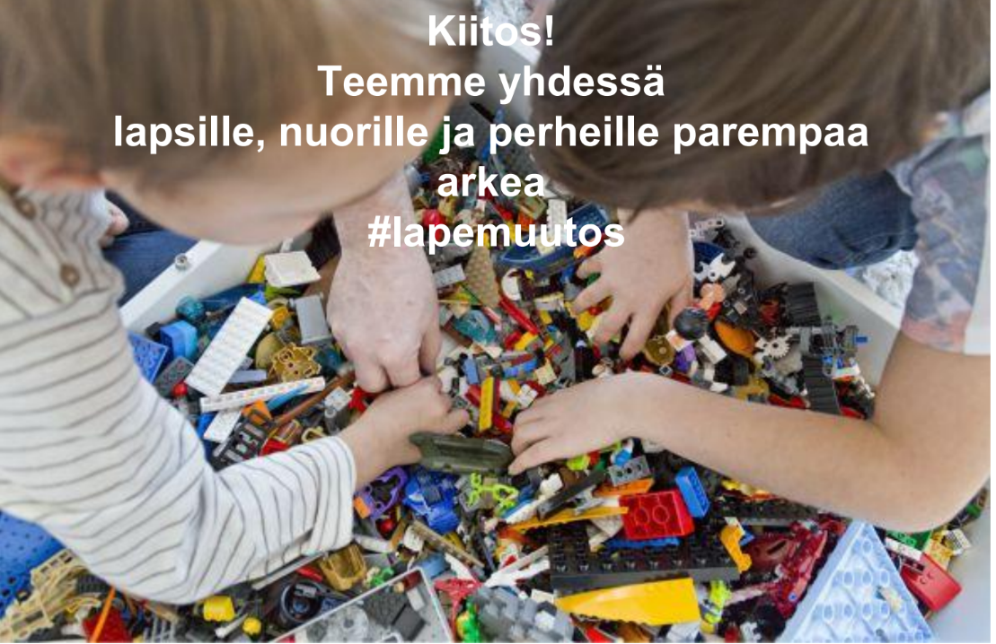
Thank you! mariakaisa.aula (at) hyvaks.fi @mariasgarden (instagram) also at Linked in
mariakaisa.aula@hyvaks.fi
@mariasgarden
Linked in Maria Kaisa Aula
Thank you!
The work for better integration of services to support the good life - will probably never end!

