Slide 1
Family centres in Finland – multisectoral support for children, young people and families Electronic Family Centre
Marina Wetzer-Karlsson
Väestöliitto

Slide 2
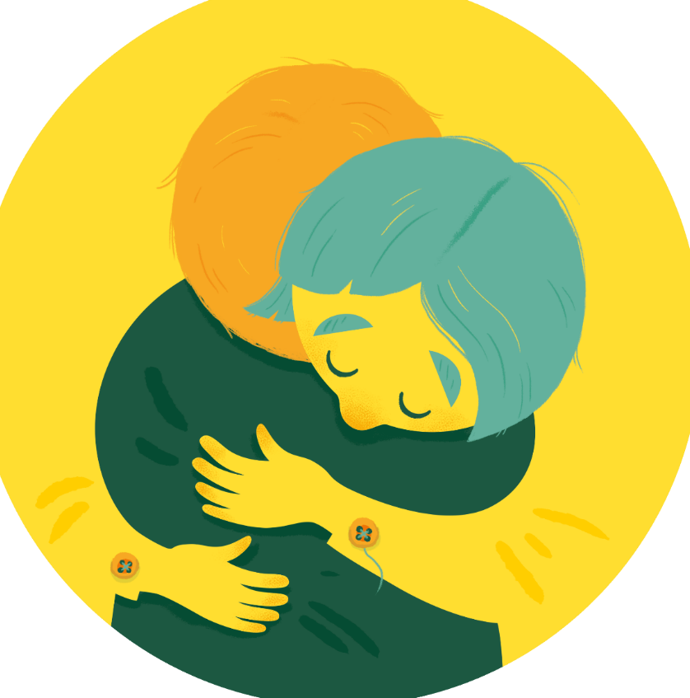
Challenges to tackle

Slide 3
How it all started?
has been developed for about 20 years and it started locally in single municipalities
spread out to cover the entire Finland as part of the Government programme during two terms of office (2016-2019 and 2020-2023). Development was speeded up with government grants and was organized on regional basis.
Coordinated by the National Health Institute, Finland
was modeled by the family centres e.g. in Norway, Sweden and Netherlands
was facilitated by a co-design structure which brought together regional and national level actors (The national Family Centre network)

Slide 4
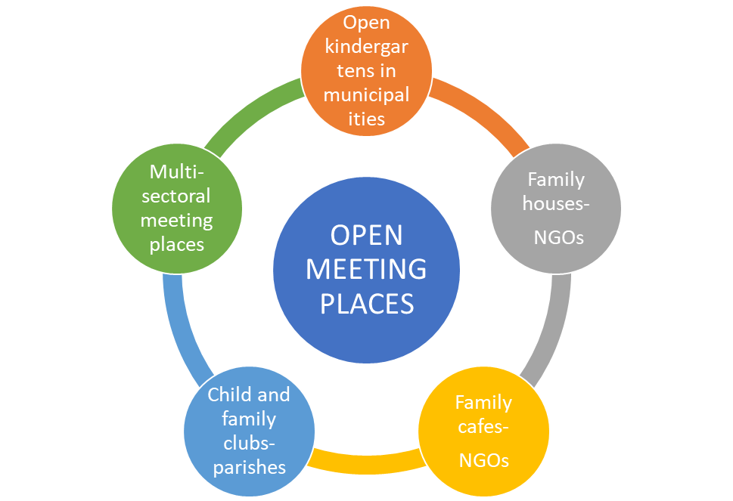
What are we aiming for?
Support children, young people and families coordinated and provide support
To offer help and support to families close to their everyday life on a low threshold (Open meeting places)
The role of NGO’s is crucial
E.g. low threshold anonymous support, peer support
Prevention is in the core of Family Centres
Reduce inequalities of wellbeing and reduce costs of corrective services
NHI, H. Kalmari 2025

Slide 5
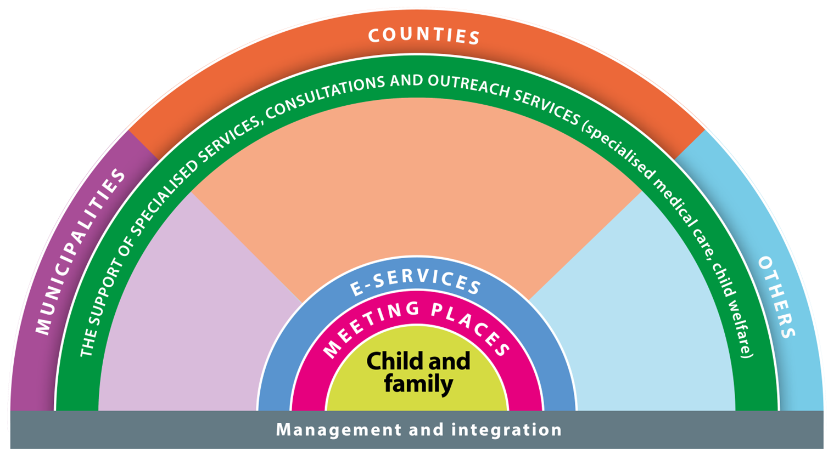
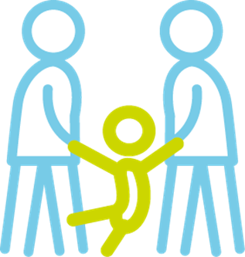
The Family Centre: Supporting everyday life
The social and health care services
for families with children
incl. Home help service, family work, parenting and family counselling, social work for families
^{with children,}
^{services of family law}
incl. maternity and child health
clinics, physician and psychologist
^{services, physical, speech and}
^{occupational therapy}
^{Services of municipalities}
^{and activities promoting}
^{health and welfare}
^{in municipalities.}
^{The activities and services}
^{of non-governmental}
^{organisations}
^{and parishes}

Slide 6
Where are we now?
Around 150 Family centres in 21 welfare counties.
Most of them are according the model. Some variation.
In most counties the network of the Family centres covers the whole area of the county.
There are meeting places for children and families in all the welfare counties, over 550 in total. Support and activities provided by well-being counties, NGOs, municipalities, parishes in co-operation with voluntary workers
Low threshold meeting places that are open for families are important

Slide 7
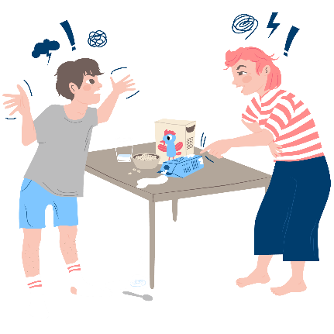
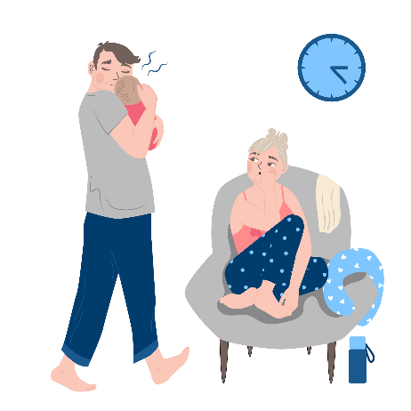
The electronic family centre is divided into three user group specific sections
Expert information, self-care instructions, and peer support, as well as instructions for national, third sector, parish, well-being services counties, and municipalities services
Free and open data between professionals in regions
Getting pregnant, pregnancy and childbirth
Children’s age ranges
Parenthood and relationship support
Concern about a child or a young person
For families
and those starting a family;
information and service portal
- Omaperhe
Professional data bank within the region and
cooperation between regions (preliminary)
Information content and instructions for professionals
The organisation's operating instructions
Customer instructions
Professional services directory/
Need for consultation
Event calendar
Mental health
Physical health
Management of everyday life
Study and work
Not feeling well
Relationships
Body and sexuality
Social influence
Information and service portal for young people
- Helpperi
16 Welfare counties, Includes also NGO services info
National Health Institute, Hanne Kalmari 2025
1
2
3
4
Electronic family centre

