Slide 1

Policy and service ‘silos’: an understudied barrier to gender equality
This project has received funding from the European Research Council (ERC) under the European Union's Horizon2020 Research Innovation programme (Grant agreement No 771290). ​
Prof. dr. Mara A. Yerkes
Utrecht University
Notes:
An 8-year-old boy falls on the school playground, breaking his arm. His mom gets a call from school, and rushes from work to pick him up and heads to urgent care at the local hospital. Upon arrival, the clerk says to her, “Do you have identification for your son? We’re not supposed to treat him without it.” The mom, who is worried about her son’s health and how to arrange everything at work, school, and home the coming weeks, is now also confronted with needing to understand and navigate her way through the medical system in order to ensure her son gets adequate care.
Another parent also receives a notification from school but this time, it’s the most recent in a series of communications with the teacher. Their child is perceived to be underperforming and misbehaving at school and the school now believes assessments are needed to determine whether the child has some form of neurodivergence. The parents are struggling to make ends meet, working multiple jobs, with little flexibility to come to school and meet with teachers during school hours. They’ve tried getting help for their child through the municipality, but are still on a waiting list. In the meantime, the afterschool care has suggested that if the behavioural problems continue, that the child will need to be moved to another school, one better equipped to help them. The parents are feeling overwhelmed and unsure what to do.
These parents are not alone. Composite stories like these mirror stories that we hear from parents, including many parents we spoke to during a 6-year European study into gender inequality and work-life balance. I start by sharing such composite stories to highlight the difficulties many parents, and caregivers, experience when combining having a paid job and caregiving. And when they experience difficulties like these, it impacts their health and wellbeing. For example, research shows us that parents who constantly feel stressed out or constantly feel they never have enough time in the day, can end up feeling overwhelmed – which, in a worst-case scenario, can lead to parents detaching emotionally from their children – meaning they stop enjoying being a parent (which clearly not only affects parents, but also their children, and their relationship with a partner if they have one).
In this brief keynote, I want to explain why – from a gender equality perspective - sectoral fragmentation in service provision for families with young children needs to be overcome. And why we need to bridge gaps between work-family, health, social services, and education policies. Not just for parents, children and families, but for our societies and economies.
Before I start: Acknowledge the CAPABLE team.

Slide 2





Notes:
A little more than seven years ago, I stood in front of a committee of 17 scientists and made my case for funding for the CAPABLE project with the European Research Council. I started my presentation by saying: Gender inequality in work and family is one of the most persistent inequalities of the 21st century. In most talks I’ve given since then, I often still use this sentence – because it remains true. Inequalities related to gender were and remain a crucial issue in contemporary societies. Inequalities in paid work, in care, in leisure, opportunities for volunteer work. And these inequalities don’t just affect women. They effect men, families, our economies, communities and societies.
This isn’t to say we aren’t making progress. We are. Despite recent pushbacks in some European member states (and other countries, as we’re well aware), there is significantly more attention for gender inequality in relation to work-life balance now compared to seven years ago. Many European member states have increased the policy support available to working parents and carers as a result of what’s known as the WLB Directive, for example, which was passed in 2019 (and sets out minimum levels of paid parental leave for each parent, paternity leave, flexible work legislation and carer’s leave). But plenty of work is left to be done, at multiple levels: at the European level, where the EU is preparing the upcoming gender equality strategy 2025-2030, at the member state level, in relation to reflecting on current work-life balance supports and where these can be improved, at the organizational level, in relation to facilitating and supporting employees in their pursuit of a multitude of activities, including but certainly not limited to care, at the local level, including municipalities, NGOs and civil society, to ensure people have access to a wide range of help and services needed in the everyday reality of working, caring, and everything else – and across these levels, ensuring effective policy coordination takes place.
Today what I’d like to do is share findings from the CAPABLE project, look back on six years of research and reflecting on think about why – despite this progress – gender inequality remains so persistent.

Slide 3

Work-family policies: crucial but insufficient
Critical source of support for parents and carers
But: in practice, workers often lack access
Result? Serious and persistent inequalities
Notes:
We started the project acknowledging the importance of work-family policy support.
Those of us working in the area of family policy know: work-family policies really are often an important source of support for parents and parent carers. In fact, having access to these policies have been shown to help improve people’s health and wellbeing.
But what we knew at the start of the project, was that despite really significant advances in work-family policies, like the European WLB Directive, and research into these policies, in practice, workers often lack access to the resources and support they need to effectively combine work with care – and other valued aspects of their lives.
So what? Well, when some people can access the resources and support they need and others can’t, this can lead to serious and persistent socio-economic inequalities. Most certainly around gender,but also class, race, ethnicity, and more.
Based on six years of research into the topic of gender inequality in work--life balance, across multiple European countries, what we see is this:
work-care problems are even more complex than currently recognized by much scientific research. Why? When the person you’re caring for needs medical care, the potential for problems, inequality, and ultimately, negative effects for people’s health and wellbeing, increases. Does the person you care for need medical care? If so, you’re no longer just trying to understand and navigate the system of work-family policies (Can I take time off work to bring my mom to the hospital? Can I work flexibly when my kids are sick? How does this affect me and my family financially in the short term and the long term?) you’re now ALSO having to understand and navigate the health care system (Which medical services does my parent, partner, or child need? How can we access them? When? How will we pay for it?). Having to navigate multiple systems at the same time creates complexities we, as scientists, have yet to understand. But if we don’t work to understand it better - the impact on parents, caregivers, employers, economies, and societies will be significant.

Slide 4

Navigating multiple, complex systems
Parents and caregivers often navigate multiple and complex policy and system landscapes
Finding and processing information
Identifying and accessing policies and services
Systems with different ‘languages’, people, norms, expectations
Crucially, when people have problems finding their way through these multiple systems, it can end up negatively impacting their lives, and family and children’s wellbeing, and ultimately our economies and societies.
Notes:
In short: one of the key barriers to achieving gender equality in work and family is the increased pressure placed on parents and others to navigate multiple, complex policy and service systems.
Look, we’re certainly not the first scientists to talk about how complicated the social or medical systems are. But what I’m suggesting is that if we, as a society, want people to have access to adequate policy support - then we need to have more attention for the multiple policy and system landscapes that working parents and caregivers must navigate, and their complexity. Navigating multiple systems means that people have to work out whether they have a right to time off from work, whether they can ask their employer for some flexibility, what the impact of that means for them financially, as an individual, or as a household. And at the same time, people have to find their way through the health care system landscape. One male caregiver we spoke to in London explained just how difficult it was to find out what services were available: “It was quite difficult because we’ve been trying to look for quite some time and there’s lots of different information, volunteer organisations, and non-voluntary organisations, […] and there is a lack of information in the mix throughout. And it’s not like there’s a single place you can go to for all the information, it’s just like spread out […] so it takes us some time to find out the right people and if they are the right services.”
Even if people work out what work and care supports there are, and health care services, it doesn’t mean that accessing them is easy. For example, our study into childcare service availability and accessibility for parents of children with additional and complex care needs shows that parents can face serious accessibility issues, such as physical access in the form of a ramp and/or elevators, sound-proof and/or light-effect free rooms, and calm-down rooms are available. But accessibility issues can also arise for parents attempting to access benefits, such as additional financial support. Needs assessments, or other eligibility criteria can create additional layers of complexity that parents must navigate in order to combine paid work and care in valued ways.
When parents and caregivers have to navigate these multiple AND COMPLEX policy landscapes, this means: SLIDE

Slide 5
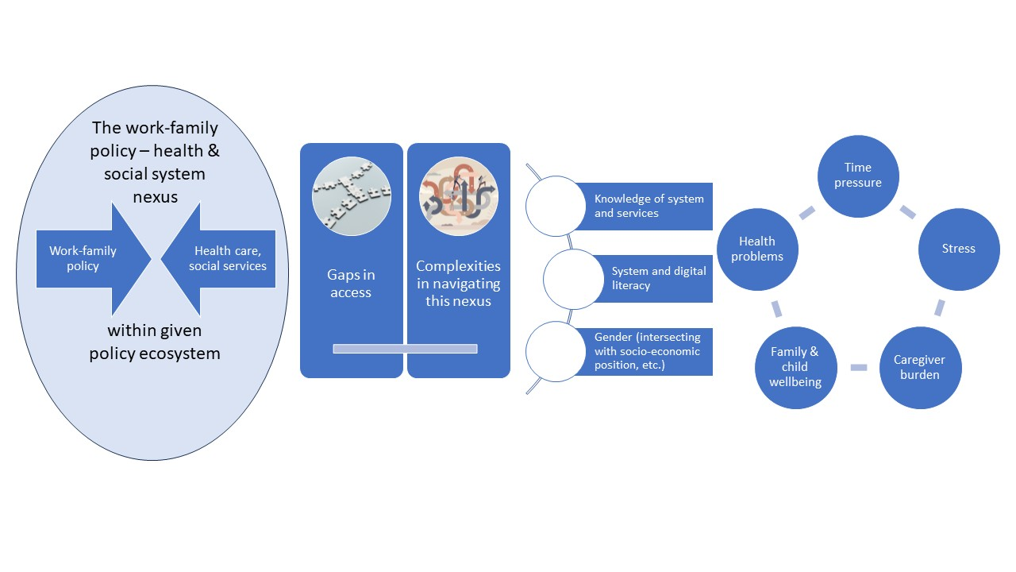
Improving access and cross-sectoral collaboration
Notes:
Here is a visualisation of what’s happening.
[To overcome these problems, greater cross-sectoral collaboration is needed]

Slide 6

A Year Like No Other; Patrick et al., 2022: xviii.
Notes:
So how can we overcome sectoral fragmentation in service provision? Well, one way of doing this would be to “pull the thread.” What I’m referring to is the foreword of the book A Year Like No Other, which provides a raw account of what life on a low income was like during the pandemic in the UK. The participants in this study stated it better than I could: “Little changes to the system, the small asks, whilst useful, feel like a compromise, an apology for daring to speak up. Because what we really need to change is the cause, not just the symptoms. The reason things are like they are. The common thread that runs through the entire system. It feels so daunting because it is. It’s a thread that once pulled would unravel so many related systems and established processes. But that doesn’t mean we shouldn’t pull it.” (Patrick et al., 2022: xviii).
This can be one part of the solution – thinking about pulling the thread.
At the same time, within the CAPABLE project, we had multiple conversations with policymakers at various levels (local, national, European) from the various countries involved in the project over many years. And we’ve talked about not just pulling the thread, but also thinking about what IS working. These are complex conversations with many moving parts – that are still ongoing. There is recognition in these conversations – of the problems that are there and the need to address them. And efforts to work together. [give talking points for the break-out sessions: what is working? What isn’t?]

Slide 7
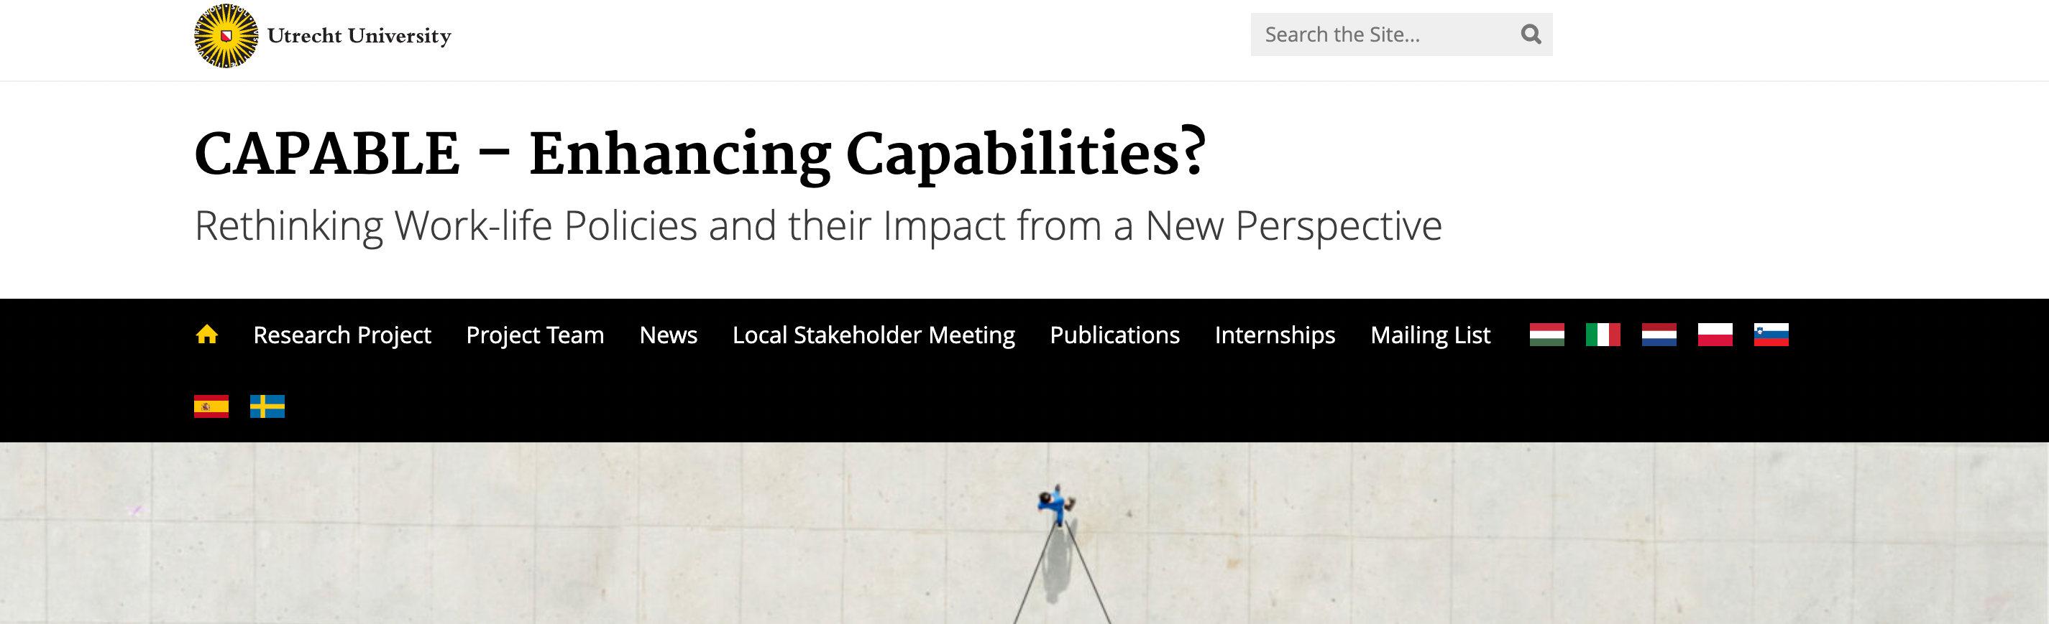
Thanks for listening!
✉️: M.A.Yerkes@uu.nl
🌐: www.worklifecapabilities.com

