Slide 1


Inequalities in European Resilience Challenges to overcome cumulative inequality Rense Nieuwenhuis
reusilience.eu
25 September 2025
This project has received funding from the European Union’s Horizon Europe research and innovation programme under Grant Agreement No Project 101060410 and Innovate UK, the UK’s Innovation Agency.

Slide 2
Background & Question
The high-level group on the future of social protection (2023):
Foster resilience … to respond to large-scale societal megatrends,
Including trends in employment and labour income inequalities
Group-level inequalities:
Exposure to labour market risks (“Need to be resilient”)
Avoid poverty upon exposure (“Capacity to be resilient”)
Question:
To what extent can group-differences in poverty be explained by cumulative disadvantages in need and capacity to be resilient?

Slide 3
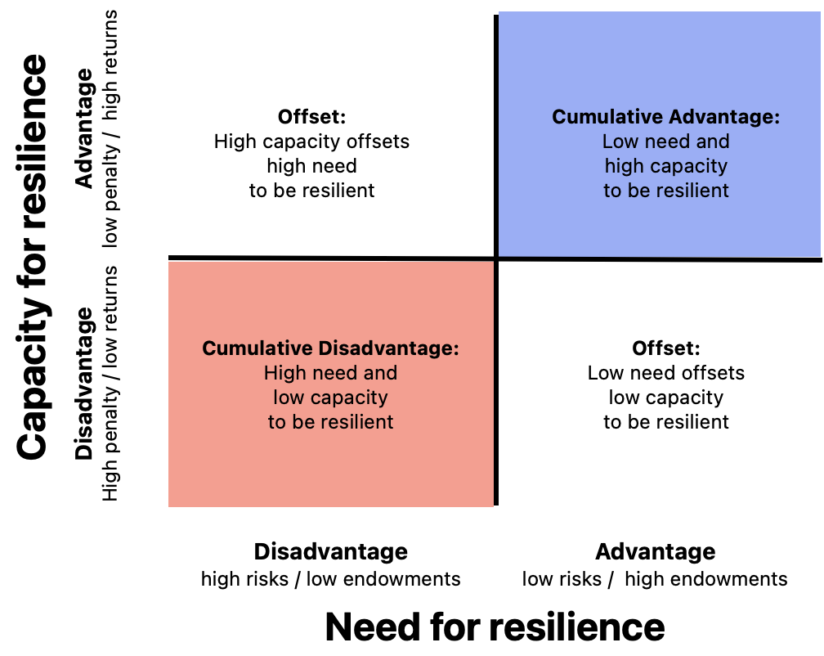

Slide 4
Cumulative inequality by Family Type

Slide 5
Inequalities in resilience framework
Those who have the least capacity to be resilient, are the ones most exposed to labour market risks
High degree of consistency across:
Family and Education
Labour market risks
Poverty dimensions
Countries

Slide 6
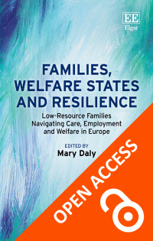
Focus group interviews
Focused on low-resource families:
Developments and transitions
Resources
Levers for change
Barriers to change
Over 300 informants, in Belgium, Croatia, Poland, Spain, Sweden, and United Kingdom
Quotes that follow are from Belgium (Gijbels et al.,) and Sweden (Backman et al.)

Slide 7
Complexity to work (Belgium)
“People want to work. They can’t get there because they don’t have transport. And then there are still the little kids, huh. Children need to go to school. They need to be taken, they need to be fetched. ... Try and get a place at daycare. That won’t do, right. And then they say, “You don’t want to work.”

Slide 8
Impossible choices (Sweden)
“I had to reduce my working hours. Partly because my daughter has diagnoses, and needs a lot of support, but also for the younger sister who can't have such overly long days at preschool, it's too much for her, she can't cope with it.
And then it becomes an economic question, of course. That is the impossible choice you have to make.”
Notes:
Parents often prioritized their children. Also example of a woman who skipped meals.
Trade-offs like these are strongly gendered, and have long-term financial consequences.

Slide 9
Barriers to change (Sweden)
It’s difficult to have a problem that is uncommon when you need assistance from a public authority. You always need a certificate ... This certificate may take several years to get, although you need help immediately.
“And when they [the public authorities] are done with the matter, things are worse because you weren’t assisted immediately. It turns into a snowball effect …”
Notes:
Particularly parents commented on how long it took to receive support.
Certification
Uncommon problems
Often only support when hitting rock-bottom, rather than prevention

Slide 10
Selected general findings
Agency:
Families go to great lengths to make the most of the little they have, often with a strong priority to their children's well-being.
Compounded hardship: inadequate work, income, housing, care, health, isolation, perceptions of discrimination.
Structural and operational weaknesses in the welfare state
Structural: failure to cover family-based needs, benefits levels too low, complex and inconsistent rules
Operational: too much bureaucracy, delays and inflexibility, and stigmatizing treatment by staff.

Slide 11
Policy to support resilience?

Slide 12
The challenges of cumulative inequality
Perspective | Inequality question | Policy Question
Path dependency (Merton) | Timing and nature of the growth curve of early (dis)advantage | Timing of interventions Life-course sensitive vs. life-course relevant “Matthew effects”
Status dependency (Blau & Duncan) | Group differences in risks/resources and penalties/returns | Reaching vulnerable groups Coverage Eligibility Take-up
Compounded hardship (Wolff & De-Shalit) | Process of compounding | Policy packages, rather than singular interventions Policy complementarity Coordination between welfare offices

Slide 13
rEUsilience policy principles
15 principles in three areas
Better Income Support for Families with Children
Closing the Childcare Gap
Comprehensive Family Support Services
Characterised by
Universalism
Adequate provisions
Complementarity of policies
Explicitly considering the family (rather than only individuals)

Slide 14
Thank you
Contact
Rense Nieuwenhuis
rense.nieuwenhuis@sofi.su.se

