Slide 1
The Family Center System in
North rhine-Westphalia
„Breaking silos, building futures. Policy innovations
for integrated family and child Support“ – COFACE
Families Europe & the Odisee Centre for Family Studies
Brussels, September 25th, 2025
Stream I: Expanding the Boundaries of ECEC
Dr. Sandra Fischer

Slide 2
1 ECEC in Germany‘s federal system 2 The family center System in NRW (North Rhine-Westphalia) 3 guiding principles and practical Examples 4 Conclusion: Opportunities and Challenges 5 Bibliography
Content

Slide 3
1 ECEC in Germany‘s federal system

Slide 4
1 ECEC in Germany‘s federal system
National government: sets a framework through the Social Code VIII, e.g. by establishing legal entitlements (§ 24 SGB VIII) or regulating to a certain degree the structure of parental fees (§ 90 SGB VIII)
Länder: specify this framework and determine the educational and organizational structure of the services
Municipalities: the youth welfare offices are responsible for the local infrastructure and the fulfillment of the legal entitlements
Non-profit providers (freie Träger), e.g. welfare associations: generally provide the services (approx. 70% of daycare centers are run by non-profit providers, 30% by public providers)
Funding: primarily by the Länder and local authorities; additionally, in most Länder parents have to pay fees, which vary between the Länder and often within each Land as well

Slide 5
2 The family center System in NRW (North Rhine-Westphalia)

Slide 6
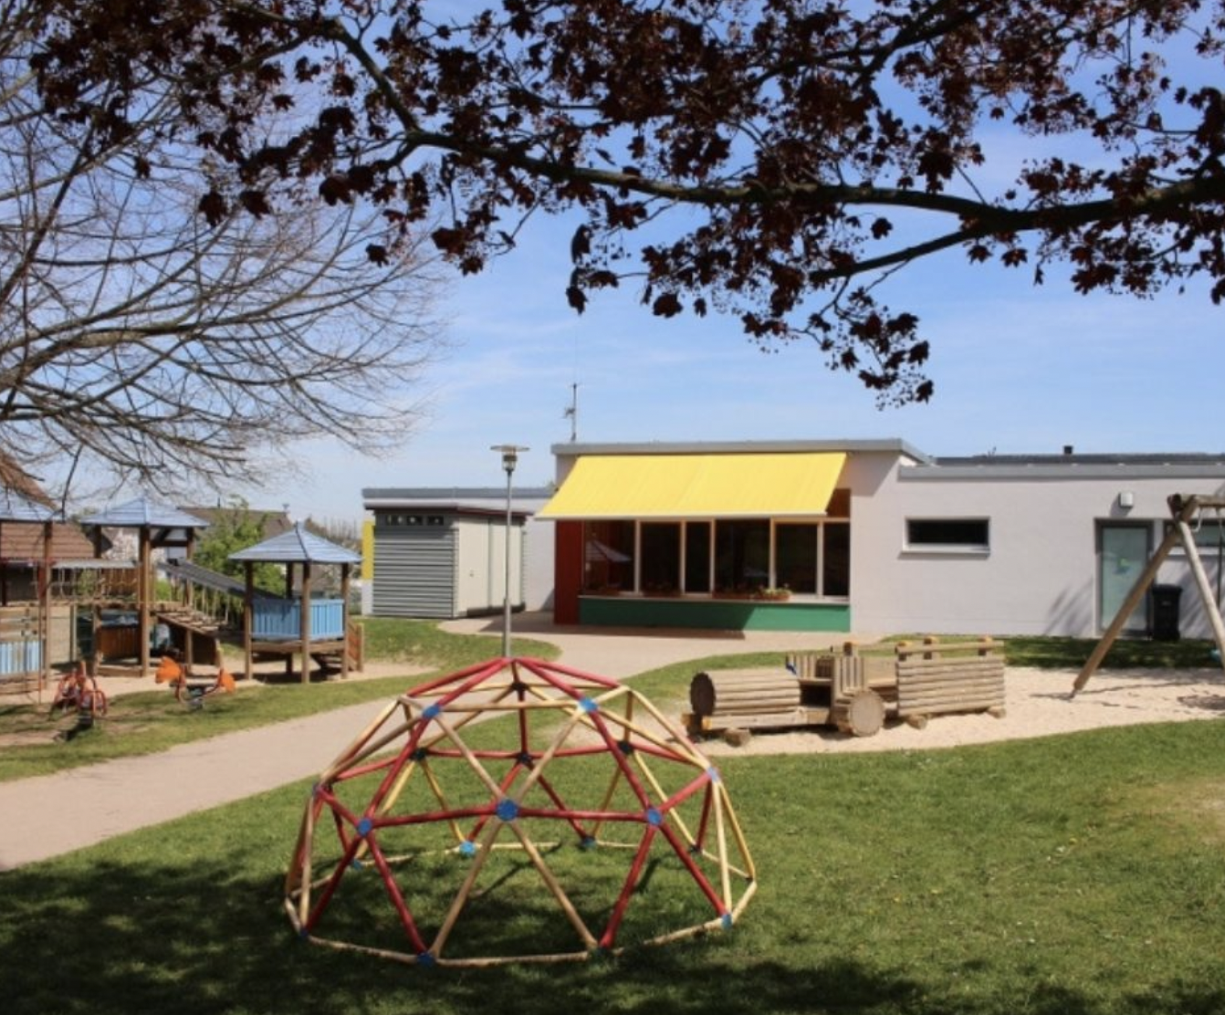
2 The family center System in NRW I
Even before 2006, there were a few family centers in NRW initiated either by municipalities or non-profit providers => grassroot “movement“/“bottom-up” process
In 2006, the Land began developing daycare centers into family centers as part of a state program

Slide 7
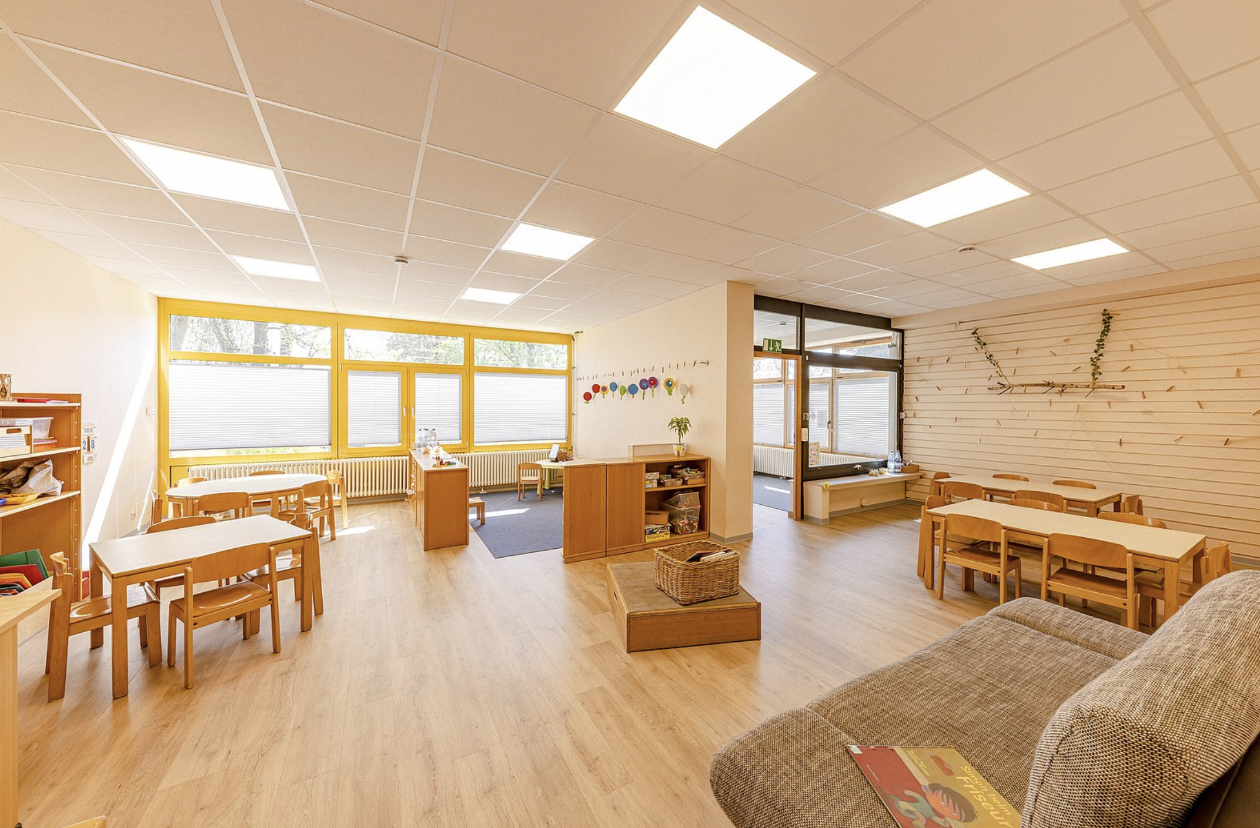
2 The family center System in NRW II
In 2007, family centers were included in the North Rhine-Westphalia Children's Education Act (KiBiz)
The prerequisite for funding is certification according to the “Family Center NRW” quality seal (valid for four years)
Since 2020/2021 amount of funding: 20,000 euros/year; dynamized since 2021/2022 (§ 43 KiBiz)

Slide 8
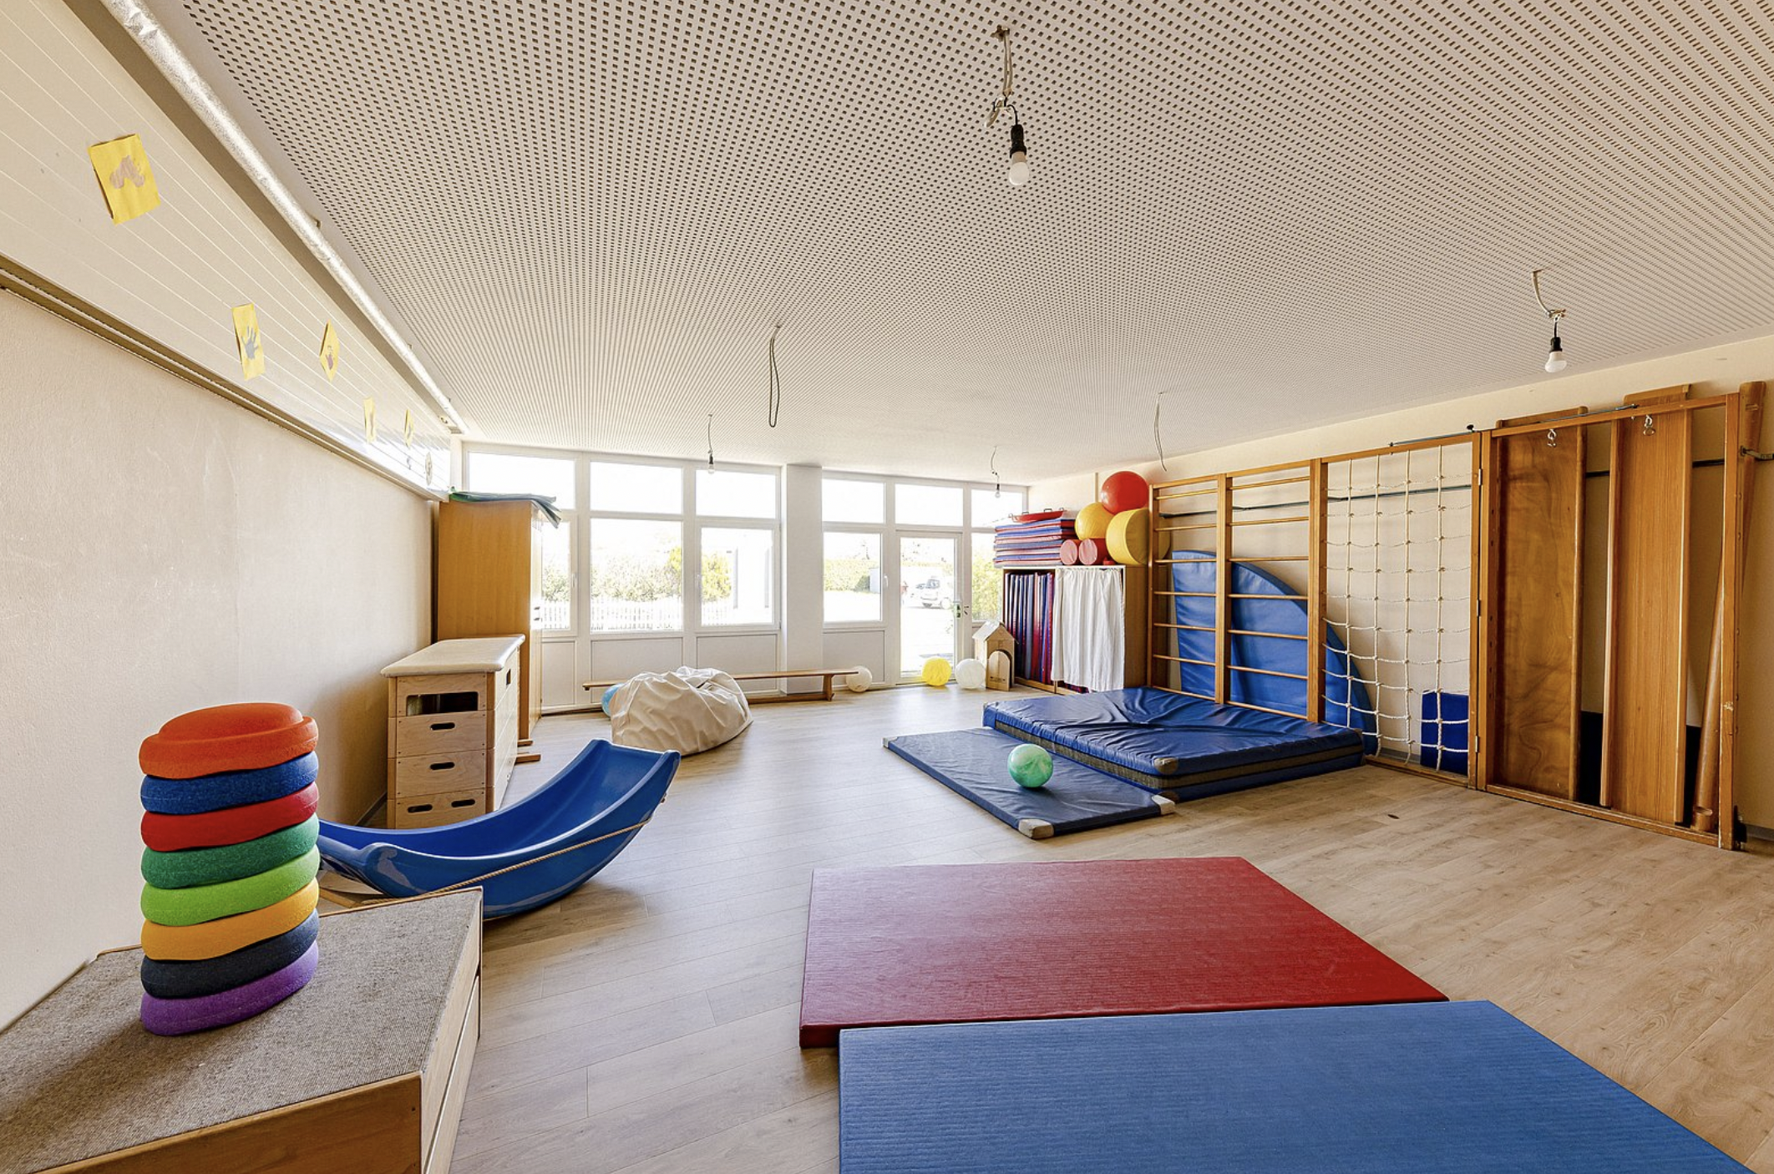
2 The family center System in NRW III
Up to now, there has been an annual expansion
In 2007, 261 family centers were certified
In 2024/2025, there were around 3,350 family centers (https://www.familienzentrum.nrw.de/landesprogramm/ausbau-und-standorte-der-familienzentren)
approx. a third of daycare centers now work as family centers
Comprehensive infrastructure in NRW

Slide 9
3 guiding principles and practical Examples

Slide 10
3 guiding principles
Legal definition: Family centers are daycare facilities that, in addition to the core tasks of educating, raising and caring for children, provide or help to find easily accessible services for advice, support and education of families that are oriented to the needs of the neighbourhood (§ 42 KiBiz; emphasis by S.F.).
3 guiding principles:
1. Orientation towards families
2. Orientation towards cooperation with external partners
3. Orientation towards the neighbourhood (Sozialraumorientierung)
The idea is to support children…
… by supporting their parents,
… by enabling easily accessible services without stigmatisation,
… by offering services from a single source,
… by fostering multi-professional cooperation.

Slide 11

3 practical Examples I: Family counseling and support/1
A core element of family centers: promoting easy access to counseling and support services for families
Family centers either expand their own services in this regard or cooperate with various external partners
Cooperation in particular with parenting and family counseling centers

Slide 12
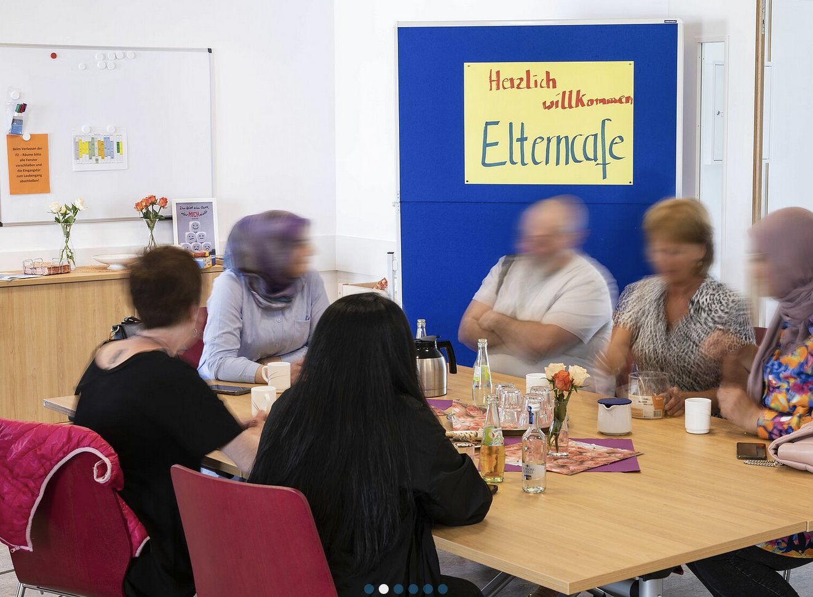
3 practical Examples I: Family counseling and support/2
A new form of service has been created: Employees of educational counseling centers offer consultation hours on the premises of the family center => easily accessible
Very often, employees of the counseling centers are also invited to parents' cafés or parents' evenings in order to provide general information, but above all to get to know each other and to build interpersonal trust

Slide 13
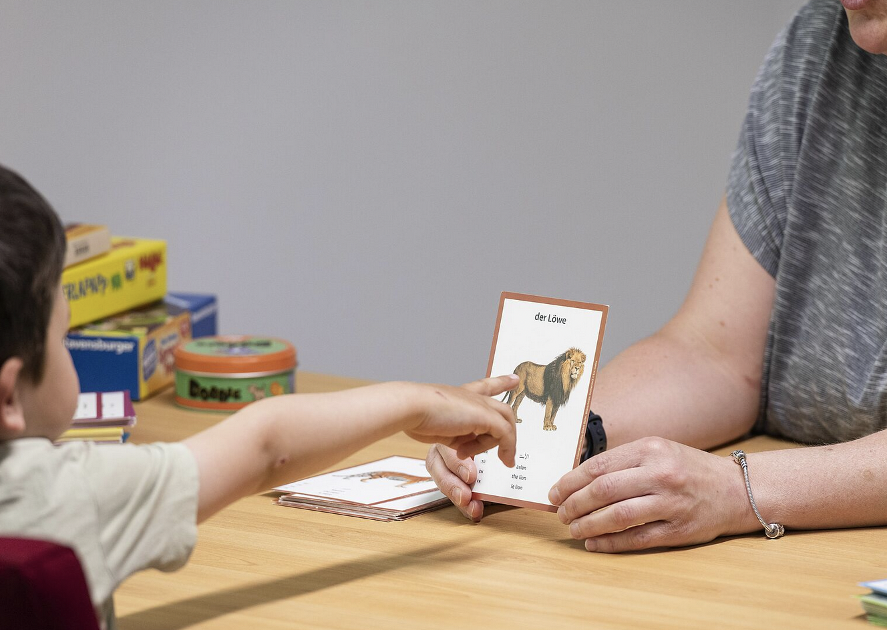
3 Practical Examples II: Health Care/1
Idea: the family center makes it possible for children to receive individual therapies either on the premises of the family center and/or through a pick-up and delivery service
Advantages:
premises for the children are familiar, integration of therapy into everyday life
easily accessible for children in all-day care and for children whose parents are unable to organize therapy appointments
Cooperation between staff and therapists: professional exchange, staff functions as a “bridge” to the parents

Slide 14
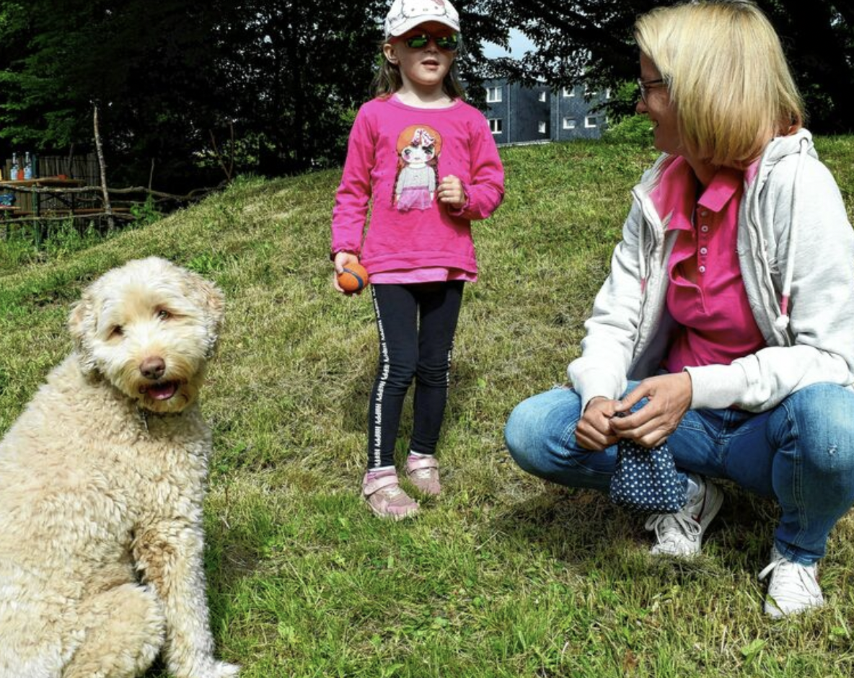
3 Practical Examples II: Health Care/2
Challenges:
(Public) health insurance: Concern about “creating demand”
Difficulties with billing („home visits“)
Skepticism among medical associations (suboptimal spatial conditions, competition problems)
Challenges at the intersection between the healthcare and the youth welfare system

Slide 15
4 Conclusion: Opportunities and Challenges

Slide 16
4 Conclusion: Opportunities and Challenges I
In an evaluation of family centers in NRW (Stöbe-Blossey et al. 2020), leaders of 36 family centers and in addition staff (16), parents (61) and representatives of the external partners (15) and of the local youth welfare offices (139) were interviewed
The work of the family centers and the cooperation between family centers and various external partners are generally perceived as an enrichment from all sides
However, there are also challenges, because …
… cooperation sometimes suffer from limited capacities – both on the side of the family centers and on the side of their partners (e.g. lack of time and financial resources and shortages and qualifications of personnel)
Moreover, cooperation sometimes suffer from regulations that actually work as barriers for cooperation (e.g. regulations in the health care system)

Slide 17
4 Conclusion: Opportunities and Challenges II
BUT: all in all, family centers are perceived to contribute to a preventive social policy by using daycare centers as infrastructure to reach children and parents where they are anyway, and
by doing so, family centers bring “family orientation“ to the fore and make „family“ visible; and
they function as an anchor/as a place to go to for the neighbourhood
Most importantly: family centers link primary (easily accessible services) with secondary (individual advice/support for problems, e.g. through educational counseling) and tertiary prevention (as a guide/Lotse by referring to specialized services outside the family center, e.g. debt counselling, social paediatric center, psychotherapy)

Slide 18
5 Bibliography

Slide 19
5 Bibliography
Bogumil, Jörg and Philipp Gräfe (2024), Fragmentierung der Sozialpolitik – Schnittstellen und Brüche zwischen unterschiedlichen Sozialpolitikfeldern. Eine Literaturstudie, DIFIS-Studie 2024/6, https://difis.org/publikationen/publikation/93 [23.9.2025].
Fischer, Sandra (2025), Sozialstaat und Demokratie, in: Thomas Hartmann-Cwiertnia et al. (Hg.), Freiheit, Gleichheit, Vertrauen. Was unsere Demokratie jetzt braucht, Bonn: Dietz-Verlag, S. 58-75.
Ministeriums für Kinder, Jugend, Familie, Gleichstellung, Flucht und Integration des Landes Nordrhein-Westfalen (2025), familienzentrum.nrw, https://www.familienzentrum.nrw.de/ [23.9.2025].
Ministeriums für Kinder, Jugend, Familie, Gleichstellung, Flucht und Integration des Landes Nordrhein-Westfalen (2020), Gütesiegel Familienzentrum Nordrhein-Westfalen, https://www.familienzentrum.nrw.de/fileadmin/user_upload/Publikationen/ISA_br_Guetesiegel_web_RZ__1_.pdf [23.9.2025].
Rietmann-Stephan and Gregor Hensen (Hg.) (2008), Tagesbetreuung im Wandel. Das Familienzentrum als Zukunftsmodell, Wiesbaden: VS Verlag für Sozialwissenschaften.
Stöbe-Blossey, Sybille (2013), Implementation of integrated services – the example of family centres in North Rhine-Westphalia, in: Early Years 33 (4), S. 354-366.
Stöbe-Blossey, Sybille (2023), Familienzentren und Familiengrundschulzentren, Forum 1: Sozialräumliche Partnerschaft – Familienbezogene Infrastruktur zur Stärkung der Gesundheit, Vortrag gehalten auf dem 8. Ruhrgebietskongress zur Kinder- und Jugendgesundheit in Essen am 18.03.2023, https://www.gesund-aufwachsen.ruhr/wp-content/uploads/2015/02/2.-FZ-und-Gesundheit-Stoebe-Blossey-230311.pdf [23.9.2025].
Stöbe-Blossey, Sybille (2025), Familienzentren in Kindertageseinrichtungen und Grundschulen als Elemente kommunaler Präventionspolitik, in: Antonio Brettschneider et al. (Hg.), Handbuch Kommunale Sozialpolitik, Springer VS, https://doi.org/10.1007/978-3-658-38616-0_34-1 [23.9.2025].
Stöbe-Blossey, Sybille et al. (2020), Familienzentren in Nordrhein-Westfalen. Eine empirische Analyse, Springer VS.

Slide 20
Thank you very much
For your attention!
Dr. Sandra Fischer
sfischer@uni-bonn.de

