Slide 1


Multisector approach to parenting support: experience and perspectives in Italy
Giorgio Tamburlini

Slide 2

Addessing the roots of adverse outcomes by promoting nurturing care through material and immaterial support to parental resources

Slide 3






Support to material resources
Support to immaterial resources
Cash transfers
Fiscal policies
Selective/indicated psychosocial support services
Services to allow Work Family Balance
Universal early parenting support services
Parental
leaves
Individual
(pre and postanatal including Home visiting
Well child visits
Group based (Parents and Children Centers, Villages, «open» ECEC services)
ECEC
services

Slide 4
The importance of immaterial support is based on evidence…
All parents and caregivers should be supported in developing and strengthening their responsive caregiving skills
All children in their first 1000 days should be involved in activities that are useful for their learning by their parents who must be supported in their ability to carry out these activities
WHO, ECD Guidelines, 2020

Slide 5
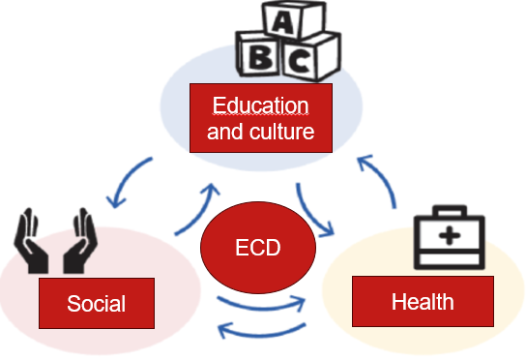
The system we are working for
Health services provide early universal involvement of parents/parents-to-be through their services to the universal intergrated parenting support program
ECEC services provide pedagogical insight into previously medically focussed services to develop a more holistic perspective of child development and parental skills
Social services provide links with the system of welfare benefits and ensure multiservice support when needed
Robust mechanisms and professional competence ensure alignment and coordination across both governance levels and service providers

Slide 6



What a multisector approach to parenting implies: health, education and social sectors to provide families with all the opportunities the community can offer : ECD/NC messages and practices are offered in all contact points (touchpoints) along the pre, peri, post natal continuum
Early bonding, skin-to-skin, BF, companion at birth
Dialogue on development
Preparation to birth
Information on community services and social benefits
Day care with family engagement and participation
Health
Services
Social
Services
Engagement of caregivers in development focused activities
(shared reading and play, music)
Education and Culture
Further support to children and families with special needs

Slide 7
Obstacles to cross-sector collaboration and integration
budgetary and organizational silos
lack of mutual recognition and common language among professionals working in diverse services and sectors
lack of awareness about what is needed and what works
good progress made for n. 2 and 3

Slide 8
Implementing multisector parenting programs: two essential and closely linked components
Multiprofessional networking and capacity building
Incorporating ECD/NC in pre-service and in-service training of health, education and social sector professionals dealing with young children and their families
Multisector coordinating mechanisms
Including health, education, social and cultural services
Including the public sector, the private- non profit sector and the corporate and commercial sectors

Slide 9
Multiprofessional training
12 to 24 hours, distributed over 2 to 4 days,
1° : science base and principles of ECD and NC
2° : assessing current state of support to families provided by services, needs and
opportunities at local (municipal- trans municipal) level
3° : roadmap of touchpoints across services and along the 1000 days services
4° : how to build a dialogue with parents/caregivers
General objective: to build common understanding and language, mutual personal and role recognition, underline the importance of a supportive dialogue with families, define a realistic, adapted to local context, roadmap for cross-sector collaboration
Trainings are requested and supported by a variety of institutions (Municipal governments,
Health Authorities, Third Sector Entities…)
Since 2023: formally NHS-supported multiprofessional NC course

Slide 10
Multisector coordinating mechanisms
Established by Municipal administrations or Municipal Consortia
Usually take the form of a «0-6 coordination table» and may evolve in «Piani di Zona» (cross sector planning on a multy- year basis)
Funding from a variety of sources, belonging to different sectors (Social, Education, Health) *
Formal Leadership by Municipal Authorities, while substantial leadership is provided by key professionals belonging to social/education/health sectors *

Slide 11
Two parallel approaches to universal multisector parenting programs
Bottom-up: scaling up the Village centers
Top-down: towards an integrated universal 0-6 system
Village centers stimulate cross-sector awareness and networking by:
Offering multiprofessional training
Facilitating collaboration to meet families’ needs
Municipalities (alone or in consortia):
set up a coordinating intersector mechanism and identify the role of each sector/service
develop a common action plan
promote multiprofessional training

Slide 12

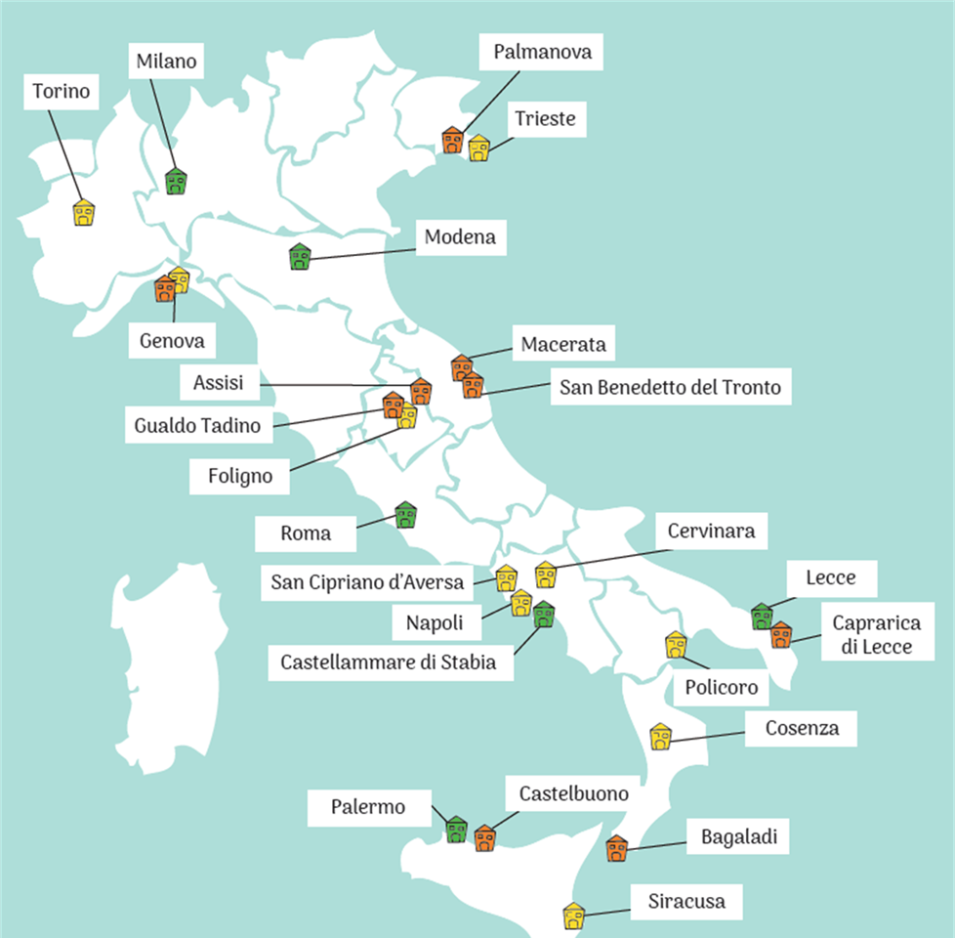
The «Villaggio per crescere» project
Started 2018…ongoing through a public-private cofunding scheme
Creates spaces («villages») for parents to spend quality time with their children 0-3 yrs, with the support of educators
19 centres set up mainly in disadvantaged urban peripheries
Managed by CSB (lead organization) with more than 40 partners (Municipalities, Schools, Health Authorities, NGOs, Academic centres, etc.)
> 2000 children and their parents involved every year

Slide 13
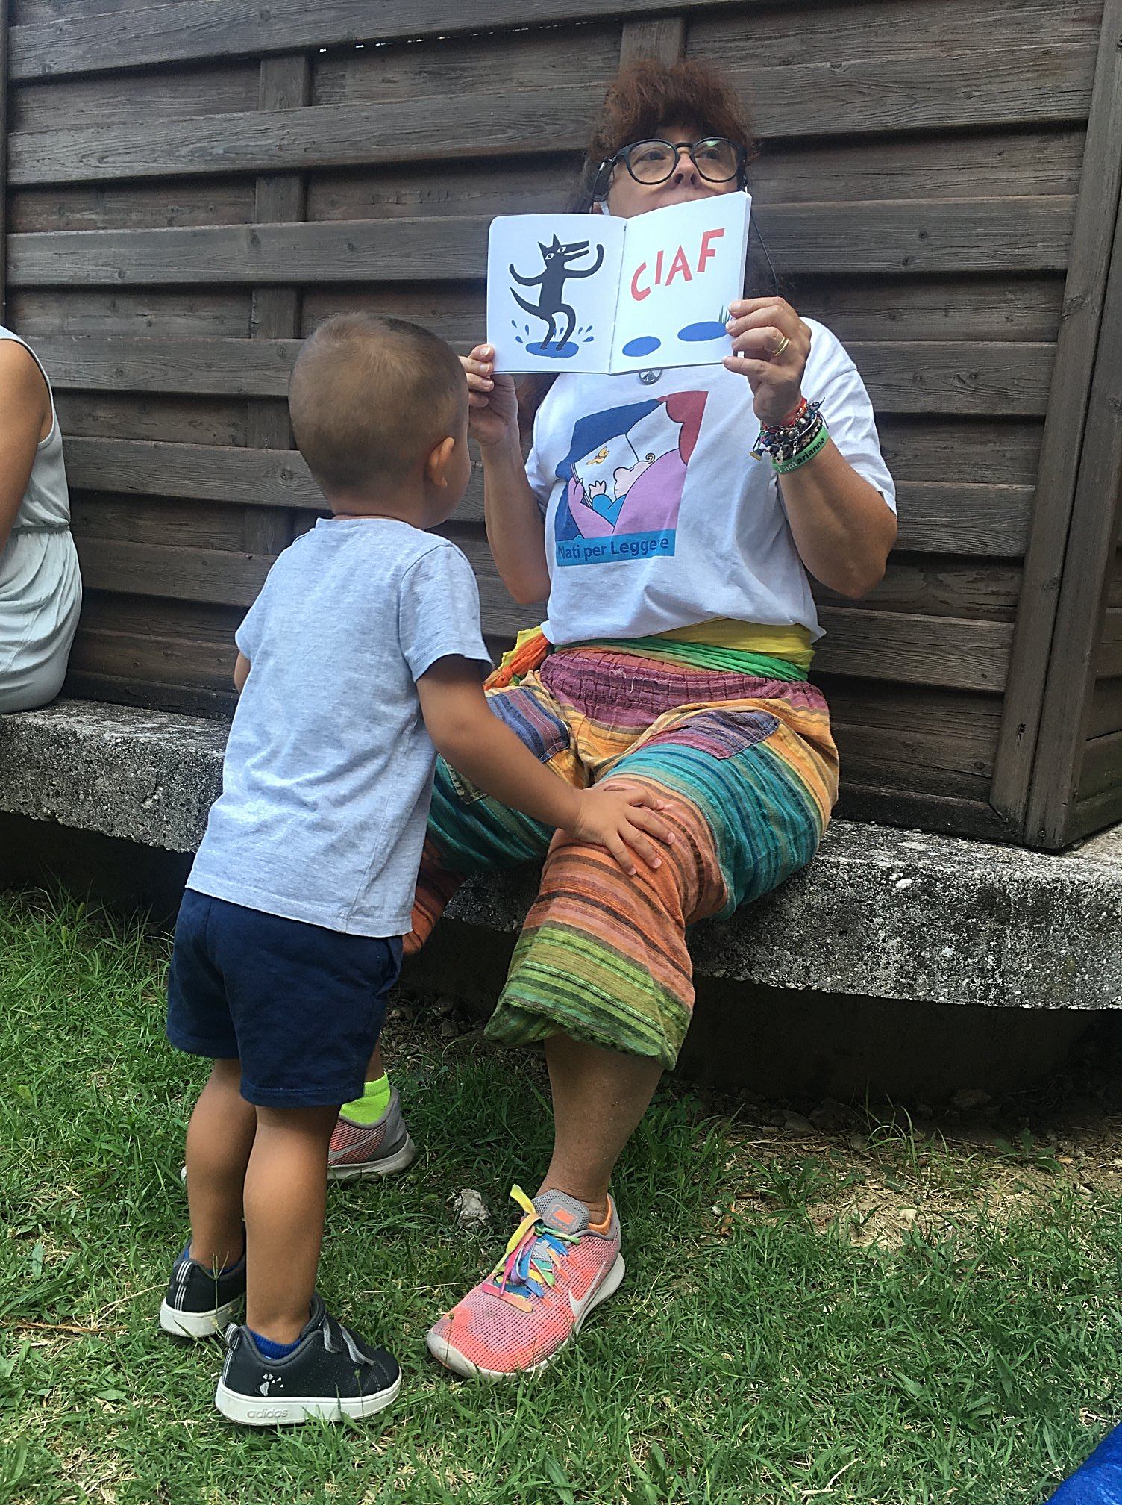

Key features of the model
Universal, area-based approach
Open access
Joint participation of parents and children from birth to age 3 (6)
Facilitation by professional educators
Promotes inter-sectoral collaboration (health, education, social services, libraries) and involves all community actors (public services, commercial, non-profit, religious, etc.)
Mix-methods MEL including counterfactual evaluation

Slide 14
Perspectives: the PRIMI PASSI program (funded by the Ministry of Labor and Social Policies, primarily through from New Generation Europe and Child Guarantee )
Three program components: cross-sector coordination mechanism,
Universal Home visiting, «Villages»
Duration: 5 years
Extension: country-wide, 80-100 areas (almost 20% of Italy’s population)
Implementation principles: local management by social services with cross-sector
collaboration, priority to disadvantaged areas, local adaptation within common
implementation principles, central coordination and peer-to-peer coaching
Coordinated by CSB and Save the Children
Mix methods MEL system

Slide 15

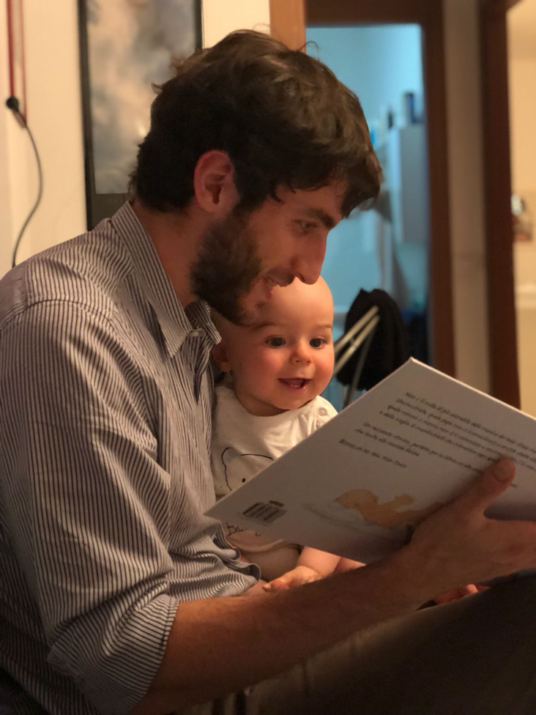
Focus since 2023: promoting early involvement of fathers (4-E PARENT EU project, EMINC project)

